Slide 1

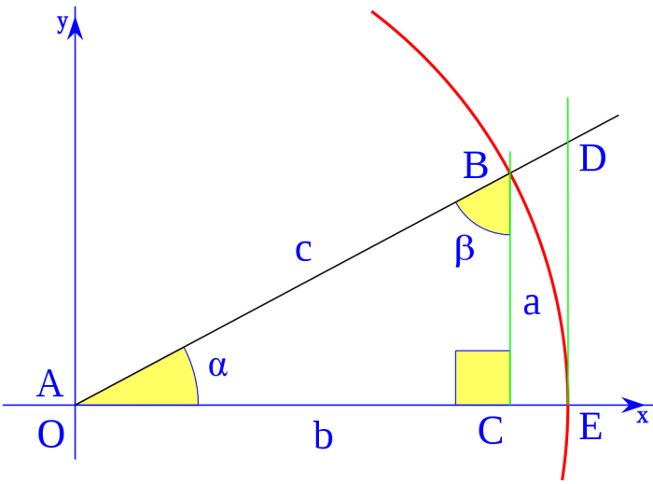



Trigonometric theorems
Contact us:
→ a.m.e.asesoriasmatematicas@gmail.com
→ asesoriasmatematicas0.webnode.com.co
→ @asesoriasmatematicas0
→ @a.m.e._asesorias_matematicas
→ Erick Duque

Slide 2



TRIANGLES
A triangle is a plane figure with three sides and three angles.
b
$$θ$$
a
$$α$$
$$β$$
c
To solve a triangle means to find all its elements.

Slide 3
Let’s see the trigonometric theorems…

Slide 4

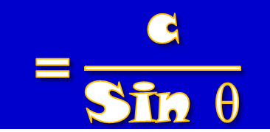

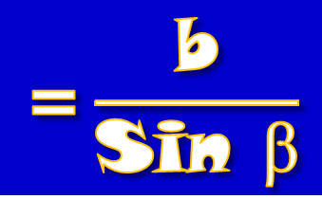
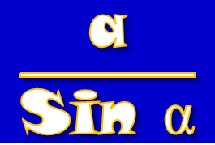

SINE THEOREM
The first theorem to study, in order to solve triangles, is the “sine theorem”
That theorem is expressed as follow:
b
$$θ$$
a
$$α$$
$$β$$
c
$$\frac{\text{a}}{\text{S}\text{i}\text{n} \text{α}}$$
$$\text{=}\frac{\text{b}}{\text{S}\text{i}\text{n} \text{β}}$$
$$\text{=}\frac{\text{c}}{\text{S}\text{i}\text{n} \text{θ}}$$

Slide 5

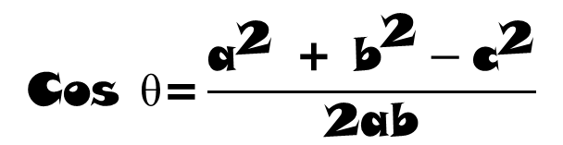

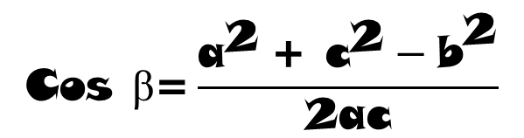
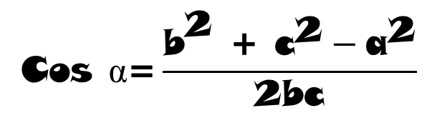

COSINE THEOREM
The second theorem is called “cosine theorem” and also it is used to solve triangles.
The theorem is expressed:
$$\text{Cos} \text{α}\text{=}\frac{{\text{b}}^{\text{2}}\text{ + }{\text{c}}^{\text{2}}−{\text{a}}^{\text{2}}}{\text{2}\text{bc}}$$
b
$$θ$$
a
$$\text{Cos} \text{β}\text{=}\frac{{\text{a}}^{\text{2}} \text{+ }{\text{c}}^{\text{2}}−{\text{b}}^{\text{2}}}{\text{2}\text{ac}}$$
$$α$$
$$β$$
c
$$\text{Cos} \text{θ}\text{=}\frac{{\text{a}}^{\text{2}}\text{ + }{\text{b}}^{\text{2}}−{\text{c}}^{\text{2}}}{\text{2}\text{ab}}$$

Slide 6
Let see some examples…

Slide 7


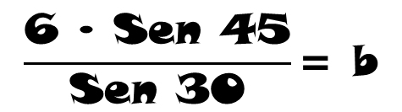
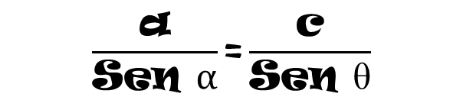

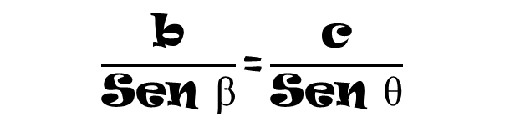

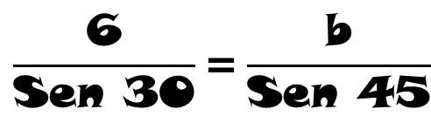
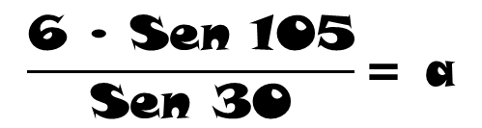

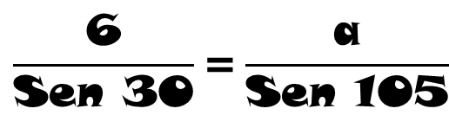
EXERCISES
Solve the following triangle:
$$θ$$
→ 30°
$$\text{θ}\text{=180}−\text{(105 + 45)}$$
$$\text{= 30}$$
a
→ 11,6 cm
$$\frac{\text{b}}{\text{Sen} \text{β}}\text{=}\frac{\text{c}}{\text{Sen} \text{θ}}$$
b
$$\frac{\text{a}}{\text{Sen} α}\text{=}\frac{\text{c}}{\text{Sen} \text{θ}}$$
→ 8,484 cm
105°
45°
6 cm
Sine theorem
$$\frac{\text{6}}{\text{Sen}\text{ 30}}\text{=}\frac{\text{b}}{\text{Sen}\text{ 45}}$$
$$\frac{\text{6 }\text{∙ }\text{Sen}\text{ 45}}{\text{Sen}\text{ 30}}\text{= }\text{b}$$
$$\text{8,484= }\text{b}$$
$$\frac{\text{6}}{\text{Sen}\text{ 30}}\text{=}\frac{\text{a}}{\text{Sen}\text{ 105}}$$
$$\frac{\text{6 }\text{∙ }\text{Sen}\text{ 105}}{\text{Sen}\text{ 30}}\text{= }\text{a}$$
$$\text{11,6 = }\text{a}$$
…now use the sine theorem again…
First, find the left angle…
…then the theorem to use…
…use the angles theorem…

Slide 8


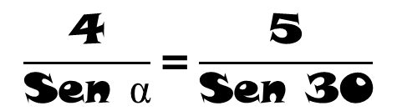

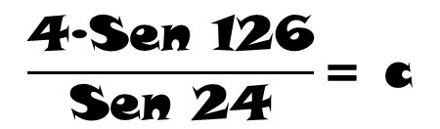
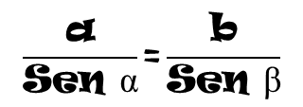

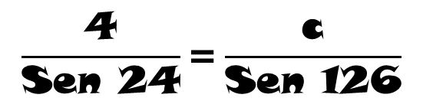

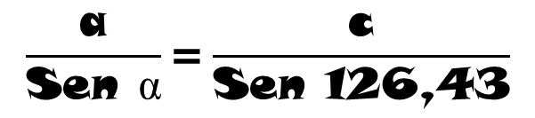
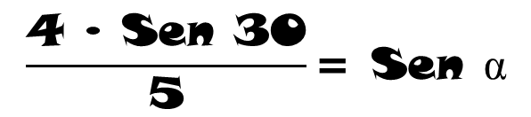

EXERCISES
$$\frac{\text{a}}{\text{Sen} \text{α}}\text{=}\frac{\text{b}}{\text{Sen} \text{β}}$$
$$\frac{\text{4}}{\text{Sen} \text{α}}\text{=}\frac{\text{5}}{\text{Sen}\text{ 30}}$$
23,57° ←
α
8 cm ←
c
b = 5 cm
$$\frac{\text{4 }\text{∙ }\text{Sen}\text{ 30}}{\text{5}}\text{= }\text{Sen} \text{α}$$
30°
θ
→ 126,43°
$$\text{0,4 = }\text{Sen} α$$
a = 4 cm
$${\text{Sen}}^{\text{−1}}\text{(0,4) = }\text{α}$$
$$\text{23,57 = }\text{α}$$
$$\text{θ}\text{=180}−\text{(30 + 23,57)}$$
$$\text{= 126,43}$$
$$\frac{\text{a}}{\text{Sen} \text{α}}\text{=}\frac{\text{c}}{\text{Sen}\text{ 126,43}}$$
$$\frac{\text{4}}{\text{Sen}\text{ 24}}\text{=}\frac{\text{c}}{\text{Sen}\text{ 126}}$$
$$\frac{\text{4}\text{∙}\text{Sen}\text{ 126}}{\text{Sen}\text{ 24}}\text{= }\text{c}$$
$$\text{8 = }\text{c}$$
…now use the sine theorem again…
Initially, apply the sine theorem…
…use the angle’s theorem…
…find the left angle…

Slide 9
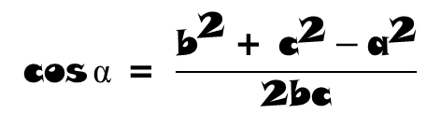

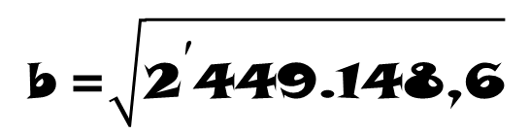

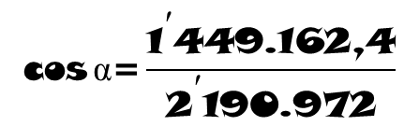

EXERCISES
b² = a² + c² − 2a⋅c⋅Cos β
b² = (1200)² + (700)² − 2(1200)⋅(700)⋅Cos 108
b² = 1’440.000 + 490.000 − (−519.148,6)
$$\text{b} \text{=}\sqrt{{\text{2}}^{\text{′}}\text{449.148,6}}$$
b² = 2’449.148,6
b = 1.564,98
$$\text{cos}{\text{α}\text{ = }\frac{{\text{b}}^{\text{2}} \text{+ }{\text{c}}^{\text{2}}−{\text{a}}^{\text{2}}}{\text{2}\text{bc}}}$$
$$\text{cos}{\text{α}\text{ = }\frac{{\text{1.564,98}}^{\text{2}} \text{+ }{\text{700}}^{\text{2}}−{\text{1.200}}^{\text{2}}}{\text{2(1.564,98)(700)}}}$$
$$\text{cos}{\text{α}\text{=}\frac{{\text{1}}^{\text{′}}\text{449.162,4}}{{\text{2}}^{\text{′}}\text{190.972}}}$$
$$\text{cos}{\text{α}\text{ = 0,684}}$$
→ 1.564,98 m
θ
b
25,2° ←
$$\text{α}\text{ = }{\text{Cos}}^{\text{−1}}\text{(0,684)}$$
α = 46,8°
α
→ 46,8°
a = 1.200 m
θ = 180 – (108 + 46,8)
= 25,2
c = 700 m
108°
Find the value of the unknown side..
…apply the cosine theorem…
…apply again the theorem…
…and then the left angle…

Slide 10
Let’s solve some problems…

Slide 11
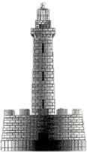
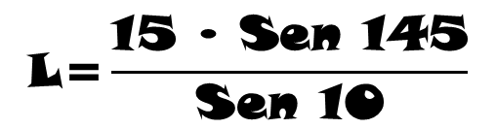
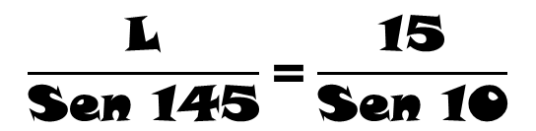

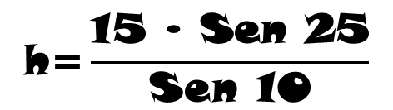
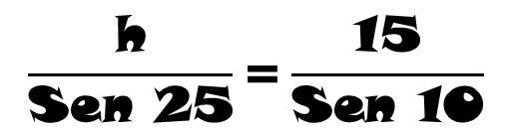

APPLIED PROBLEMS
PROBLEM 1
A tower tilted 10° from the vertical is supported by a cable from a point P to 15 meters from the base of the tower. If the angle of elevation of the cable is 25°, find the length of the cable and the height of the tower.
$$\frac{\text{h}}{\text{Sen}\text{ 25}}\text{=}\frac{\text{15}}{\text{Sen}\text{ 10}}$$
Horizontal
Observer
Depression angle
$$\text{h}\text{=}\frac{\text{15 }\text{∙ }\text{Sen}\text{ 25}}{\text{Sen}\text{ 10}}$$
10°
$$\text{h}\text{ = 36,51}$$
L
h
Elevation angle
?
$$\frac{\text{L}}{\text{Sen}\text{ 145}}\text{=}\frac{\text{15}}{\text{Sen}\text{ 10}}$$
25°
145
Horizontal
Observer
15 m
$$\text{L}\text{=}\frac{\text{15 }\text{∙ }\text{Sen}\text{ 145}}{\text{Sen}\text{ 10}}$$
$$\text{L}\text{ = 49,55}$$

Slide 12




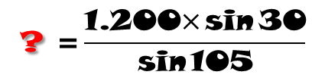
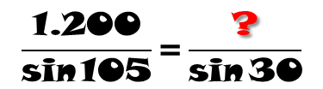
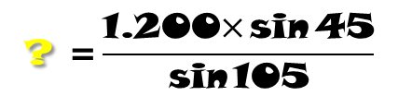
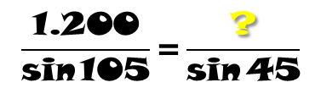
APPLIED PROBLEMS
PROBLEM 2
A person observes an airplane and a ship from the dome of a lighthouse, as shown in the figure. What is the distance from the ship to the plane and from the ship to the observer?
α = 180 – (105 + 45) = 30
$$\frac{\text{1.200}}{\text{sin}{\text{105}}}\text{=}\frac{\text{?}}{\text{sin}{\text{45}}}$$
$$\text{? }\text{=}\frac{\text{1.200}\text{×}\text{sin}{\text{45}}}{\text{sin}{\text{105}}}$$
1.200 m
α
45°
? = 878,41 m
?
?
105°
$$\frac{\text{1.200}}{\text{sin}{\text{105}}}\text{=}\frac{\text{?}}{\text{sin}{\text{30}}}$$
$$\text{?} \text{=}\frac{\text{1.200}\text{×}\text{sin}{\text{30}}}{\text{sin}{\text{105}}}$$
? = 621,17 m
Calculate the propose angle
Use the sine theorem

Slide 13
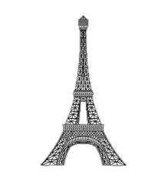
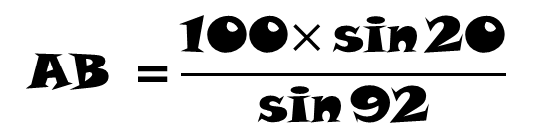
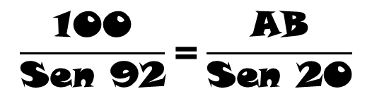
APPLIED PROBLEM
PROBLEM 3
A man measures the angle of elevation of a tower from a point 100 meters from it. If the measured angle is 20° and the tower makes an angle of 68° with the ground, determine its height AB.
B
α = 180 – (68 + 20) = 92
α
$$\frac{\text{100}}{\text{Sen}\text{ 92}}\text{=}\frac{\text{AB}}{\text{Sen}\text{ 20}}$$
h
$$\text{AB} \text{=}\frac{\text{100}\text{×}\text{sin}{\text{20}}}{\text{sin}{\text{92}}}$$
20°
68°
C
A
AB = 34,22 m
100 m
h = 34,22 × Sen 68
h = 31,73

