Slide 1



Permutations and Combinations
By: Mr. Erick Duque
Contact us:
→ a.m.e.asesoriasmatematicas@gmail.com
→ asesoriasmatematicas0.webnode.com.co
→ @asesoriasmatematicas0
→ @a.m.e._asesorias_matematicas
sin α + sin β = 2 sin

Slide 2
First, let’s talk about permutations…

Slide 3
permutations
Un ordered array of r selected elements of a set of n different elements is called permutation (n ≥ r). The order must be taken into account.
Its notation differ according with the author:
P(n, r)
_{n}P_{r}
P^{n}_{r}
^{n}P_{r}
P_{n,r}
We are going to use that
FOR EXAMPLE
Let’s see all permutations of the letters {A, B, C, D} only if two are taken at a time.
AB, AC, AD, BA, BC, BD, CA, CB, CD, DA, DB, DC

Slide 4
Let’s see the both kind of permutations…

Slide 5
permutaTions
PERMUTATIONS “WITH” REPETITION
To calculate all permutations of a set of n data, taken r elements, its formula is as follow:
n^{r}
Assume that you want to create a cell phone password of 4 digits.
then, the data set is [0,1, 2, 3, 4, 5, 6, 7, 8, 9] nd the taken elements r are 4
In that case n = 10
10⁴ = 10,000

Slide 6
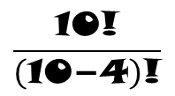
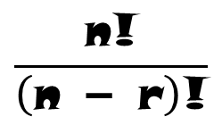

permutations
PERMUTATIONS “without” REPETITION
To calculate all permutations of a set of n data, taken r elements, its formula is as follow:
$$\frac{\text{n}\text{!}}{\left(\text{n}\text{ − }\text{r}\right)\text{!}}$$
Assume you want to create a password for your cell phone with no repeating digits.
The data set is [0,1, 2, 3, 4, 5, 6, 7, 8, 9] and the taken elements r are 4
In this case n = 10
^{n}P_{r}=
$$\frac{\text{10!}}{\left(\text{10−4}\right)\text{!}}$$
$\text{=}\frac{\text{10}\text{×}\text{9}\text{×}\text{8}\text{×}\text{7}\text{×}\text{6!}}{\text{6!}}$Z
= 5.040

Slide 7
Now, let´s talk about combinations…

Slide 8

Combinations
A combination is an unordered arrangement.
As well as permutations, its notation varies according to the author: ^{n}C_{r}, C^{n}_{r}, C_{n,}, $\left({\text{n} \atop \text{r}}\right)$
FOR EXAMPLE:
The numbers of all combination of letters {A, B, C, D} taken only two letters.
AB, AC, AD, BC, BD, CD
Written BA or AB is considered as being the same.
sin α + sin β = 2 sin

Slide 9
Let´s see the both kinds of combinations…

Slide 10
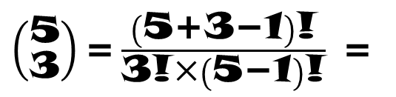
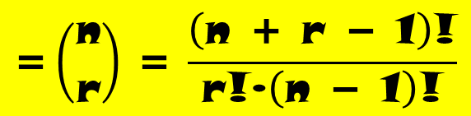
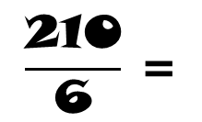
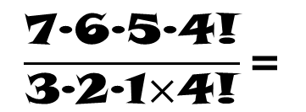
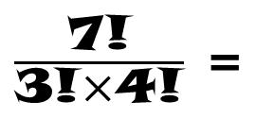
Combinations
COMBINATIONS “with” REPETITION
To calculate all combinations of a set of n data, taken r elements, its formula will be:
$$\text{=}\left({\text{n} \atop \text{r}}\right) \text{=} \frac{\left(\text{n}\text{ + }\text{r}\text{ − 1}\right)\text{!}}{\text{r}\text{!∙}\left(\text{n}\text{ − 1}\right)\text{!}}$$
^{n}C_{r}
For example: we get 5 different flavour of ice cream: banana, chocolate, lemon, strawberry and vanilla to make a cone with three scoops. How many combinations can we make?
$\left({\text{5} \atop \text{3}}\right)\text{=}\frac{\left(\text{5+3−1}\right)\text{!}}{\text{3!}\text{×}\left(\text{5−1}\right)\text{!}}$ =
$\frac{\text{7!}}{\text{3!}\text{×}\text{4!}}$ =
$$\frac{\text{7}\text{∙6∙5∙4!}}{\text{3}\text{∙2∙1}\text{×}\text{4!}}\text{=}$$
$$\frac{\text{210}}{\text{6}} \text{=}$$
35

Slide 11
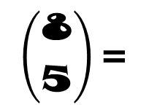
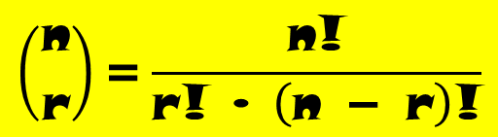
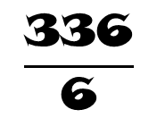
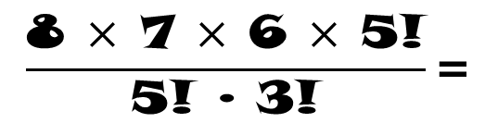
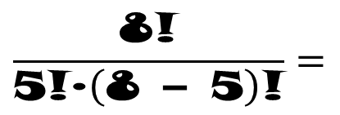
Combinations
COMBINATION “without” REPETITIONS
To calculate all combinations of a set of n data, taken r elements, its formula will be:
$$\left({\text{n} \atop \text{r}}\right)\text{=}\frac{\text{n}\text{!}}{\text{r}\text{! ∙ }\left(\text{n}\text{ − }\text{r}\right)\text{!}}$$
For example: In how many ways can 5 books be selected from 8 different books?
$$\left({\text{8} \atop \text{5}}\right)\text{=}$$
$$\frac{\text{8!}}{\text{5!}\text{∙}\left(\text{8 − 5}\right)\text{!}}=$$
$$\frac{\text{8 }\text{×}\text{ 7 }\text{×}\text{ 6 }\text{×}\text{ 5!}}{\text{5! }\text{∙ 3!}}\text{=}$$
$$\frac{\text{336}}{\text{6}}$$
= 56

