Slide 1




OPERING FRACTIONS
By: Mr. Erick Duque
Contáctenos:
→ a.m.e.asesoriasmatematicas@gmail.com
→ asesoriasmatematicas0.webnode.com.co
→ @asesoriasmatematicas0
→ @a.m.e._asesorias_matematicas
→ Erick Duque

Slide 2
FRACTIONS
It´s a number of the form $\frac{a}{b}$when a and b are integers
The number a is called NUMERATOR
It means the number to take of the unit
The number b is called DENOMINATOR
It means the number of parts in which unit will be divided
To simplify fractions means to write the fraction in lowest terms, that is to divide the both terms by the same number.
It is possible to simplify by any number provide by the same number at the top and bottom of the fraction.
For example:
36
18
6
2
54
27
9
3

Slide 3
ADDING FRACTIONS
If you are going to add TWO fractions, you can use the method called “HAPPY FACE”
3
2
21
10
31
5
7
35
35
3 ‧ 7 = 21
5 ‧ 7 = 35
5 ‧ 2 = 10

Slide 4
ADDING FRACTIONS
To add or subtract more than two fractions, you must follow the method called “4 steps”
First Step:
Find the L. C. M. (Denominators)
Second Step:
Divide by the bottom, multiply by the top
Third Step:
Add or subtract
Fourth Step:
Simplify (if it is possible)
For example:
1
3
23
4
7
60

Slide 5
ADDING FRACTIONS
1° STEP: Take the denominators and find its L. C. M.
4
7
60
2
So, the L. C. M. consist of to multiply all the number at right…
2
7
30
2
420
1
7
15
3
2
2
3
5
7
1
7
5
5
1
7
1
7
This number will be the new denominator
1
1
1

Slide 6
ADDING FRACTIONS
2° STEP: divide by the bottom and then multiply by the top
1
3
23
105
180
161
446
4
7
60
420
420
223
3° STEP: add or subtract
4° STEP: simplify (if it is possible)
210
1
13
420 ÷ 4 = 105
420 ÷ 7 = 60
420 ÷ 60 = 7
210
Para 3/7
Para 23/60
Para 1/4
105 × 1 = 105
7 × 23 = 161
60 × 3 = 180
105 + 180 + 161= 446

Slide 7
EXERCISES
19
1
1
38
6
15
29
15
5
2
30
15
5
2
2
30
15
5
1
5
3
1
1
3
1
1
1

Slide 8
EXERCISES
1
3
3
10
15
12
37
2
4
5
20
2
4
5
2
20
1
17
1
2
5
2
20
1
1
5
5
1
1
1

Slide 9
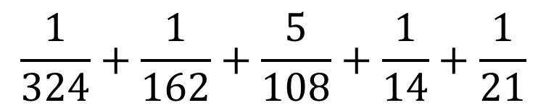
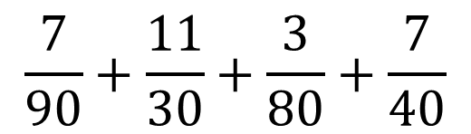
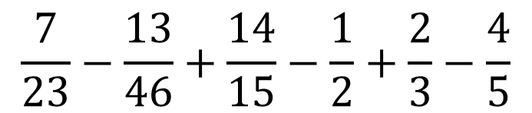
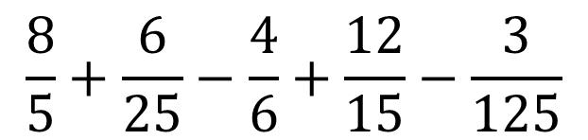
EXERCISES
Practice
Solve the following exercises
$$\frac{7}{90}+\frac{11}{30}+\frac{3}{80}+\frac{7}{40}$$
Escríbanos a nuestro correo con sus respuestas y le enviaremos sus resultados
$$\frac{1}{324}+\frac{1}{162}+\frac{5}{108}+\frac{1}{14}+\frac{1}{21}$$
$$\frac{8}{5}+\frac{6}{25}−\frac{4}{6}+\frac{12}{15}−\frac{3}{125}$$
$$\frac{7}{23}−\frac{13}{46}+\frac{14}{15}−\frac{1}{2}+\frac{2}{3}−\frac{4}{5}$$

Slide 10
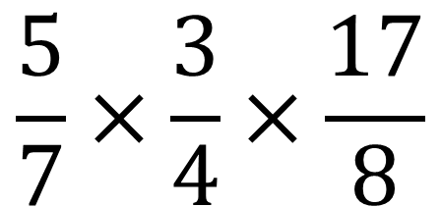
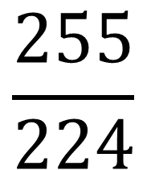
MULTIPLYING FRACTIONS
To multiply fractions, you have to multiply in front, that is to multiply numerator by numerator and denominator by denominator
Example:
→
→
=
→
→

Slide 11
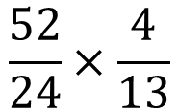
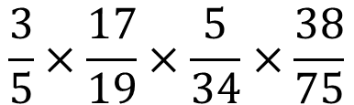
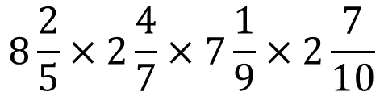
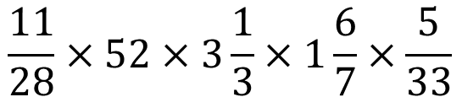
EXERCISES
Practice
Solve the following exercises
Escríbanos a nuestro correo con sus respuestas y le enviaremos sus resultados

Slide 12
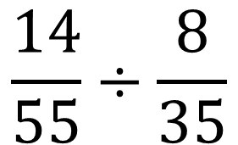
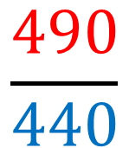
DIVIDING FRACTIONS
To divide fractions, you have to multiply in cross; in other words, to multiply the first fraction by the reciprocal of the second fraction.
Example:
=

Slide 13
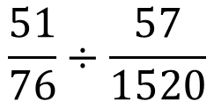
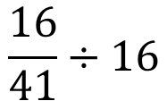
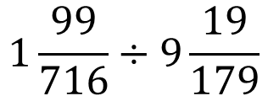
EXERCISES
Practice
Solve the following exercises
Escríbanos a nuestro correo con sus respuestas y le enviaremos sus resultados

