Slide 1




SUMA Y DIFERENCIA DE FRACCIONARIOS
Por: Mr. Erick Duque
Contáctenos:
→ a.m.e.asesoriasmatematicas@gmail.com
→ asesoriasmatematicas0.webnode.com.co
→ @asesoriasmatematicas0
→ @a.m.e._asesorias_matematicas
→ Erick Duque

Slide 2
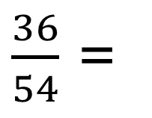
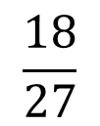


FRACTIONS
The number a is called NUMERATOR
It means the number to take of the unit
The number b is called DENOMINATOR
It means the number of parts who divides the unit
To simplify fractions means to write the fraction in lowest terms, that is to divide the both terms by the same number.
It is possible to simplify by any number provide by the same number at the top and bottom of the fraction.
For example:
=
=

Slide 3

FRACCIONARIOS
Todo número de la forma $\frac{\text{a}}{\text{b}}$ se llama fracción, donde a y b son números enteros.
El número ‘a’ se llama numerador.
Significa el número de partes que se toman.
Significa el número de partes en que se divide la unidad.
El número ‘b’ se llama denominador.
Hay tres clases de fraccionarios:
Propios
Impropios
mixtos
Propios
Numerador < denominador
Impropios
Numerador > denominador
Mixtos
Parte entera y parte fraccionaria

Slide 4
FRACTIONS
To add or subtract fractions, you must follow the following steps
First Step:
Find the L. C. M. (Denominators)
Second Step:
Divide by the bottom, multiply by the top
Third Step:
Add or subtract
Fourth Step:
Simplify (if it is possible)
For example:

Slide 5

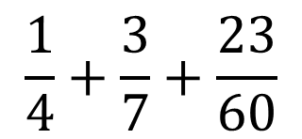
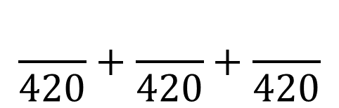
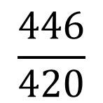
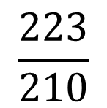
1° STEP: Take the denominators and find its L. C. M.
4
7
60
2
2
7
30
2
Multiply all prime numbers
1
7
15
3
1
7
5
5
1
7
1
7
1
1
1
2° STEP: divide by the bottom and then multiply by the top
105
180
161
3° STEP: add or subtract
=
=
=
4° STEP: simplify

Slide 6
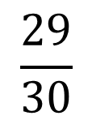


EXERCISES
$$\frac{}{30}+\frac{}{30}−\frac{}{30}$$
$$\frac{29}{30}$$
38
6
15
=
=
15
5
2
2
15
5
1
5
$$2×5×3=$$
30
3
1
1
3
First Step:
Find the L. C. M. (Denominators)
1
1
1
Second Step:
Divide by the bottom, multiply by the top
Third Step:
Add or subtract

Slide 7
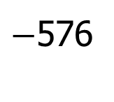

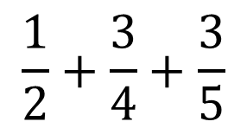

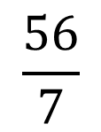
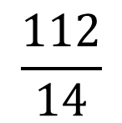
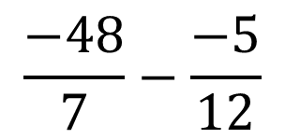
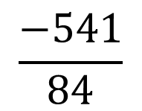
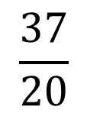

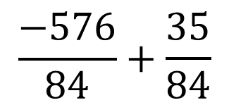


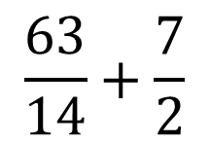
$$\frac{1}{2}+\frac{3}{4}+\frac{3}{5}$$
$$\frac{}{20}+\frac{}{20}+\frac{}{20}$$
10
15
12
$$\frac{37}{20}$$
=
=
2
4
5
2
2
20
First Step:
Find the L. C. M. (Denominators)
1
2
5
1
1
5
5
Second Step:
Divide by the bottom, multiply by the top
1
1
1
Third Step:
Add or subtract
$$\frac{−48}{7}−\frac{−5}{12}$$
$$\frac{}{84}−\frac{}{84}$$
$$\frac{−576}{84}+\frac{35}{84}$$
$$\frac{−541}{84}$$
$−$576
$$−35$$
=
=
=
63
49
$$\frac{63}{14}+\frac{7}{2}$$
$$\frac{}{14}+\frac{}{14}$$
$$\frac{112}{14}$$
$$\frac{56}{7}$$
$$\frac{8}{1}$$
=
=
=
=
=
=
8

