Slide 1




GEOMETRIC SOLIDS
By: Mr. Erick Duque
Contact us:
→ a.m.e.asesoriasmatematicas@gmail.com
→ asesoriasmatematicas0.webnode.com.co
→ @asesoriasmatematicas0
→ @a.m.e._asesorias_matematicas
→ Erick Duque

Slide 2
Solids
A geometric solids is a three-dimensional figure with length, wide and height.
It occupies a place in space and it has volume.

Slide 3
Solids
There are two kind of solids: polyhedron and circle solids
POLYHEDRON
Faces
Edges
Vertex
Each Flat surface is a polygon

Slide 4
Solids
Vertex: it is a point where 2 or more lines meet
Face: is any of the individual surfaces of a geometric solid
Edge: is a line segment that join two vertices

Slide 5
Prism
A prism is a solid object with:
identical ends
flat faces
same cross section all along its length

Slide 6
Circle Solids
They are called “NON-POLYHEDRA SOLIDS”

Slide 7
Volume of geometric solids
Any polyhedron
V = l ⋅ w ⋅ h
Cylinder
V = π ⋅ r² ⋅ h
Sphere
V = 4/3 ⋅ π ⋅ r³
Cone
V = 1/3 ⋅ π ⋅ r² ⋅ h
Pyramid
V = 1/3 ⋅ l ⋅ w ⋅ h
l = length
w = width
h = height
r = radius

Slide 8
Let’s see some examples…

Slide 9
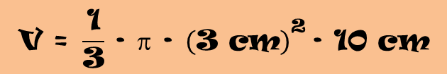
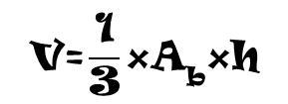
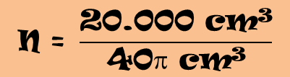

APPLIED EXERCISES
In an ice cream with a cone-shaped, 1/3 of the content sticks out of the cone. If the radius of the base is 3 cm and its height is 10 cm. How many ice creams can be made with 20 L of milk?
Let’s graph the situation
Let’s remember the Cone´s formula
$$\text{V}\text{=}\frac{\text{1}}{\text{3}}\text{×}{\text{A}}_{\text{b}}\text{×}\text{h}$$
r = 3 cm
$$\text{V} \text{=} \frac{\text{1}}{\text{3}} \text{∙} π \text{∙} {\left(\text{3} \text{cm}\right)}^{\text{2}} \text{∙} \text{10} \text{cm}$$
= 30π cm³
The content has the same shape…
h = 10 cm
$$\text{V}\text{total} \text{=} \text{30}π \text{cm}\text{3} \text{+} \frac{\text{1}}{\text{3}}\text{∙30}π \text{cm}\text{3}$$
= 40π cm³
20 L are equivalent to 20.000 cm³…
$$\text{N} \text{=} \frac{\text{20.000 }\text{cm}\text{3}}{\text{40}π \text{cm}\text{3}}$$
≈ 159,15 ice creams

Slide 10
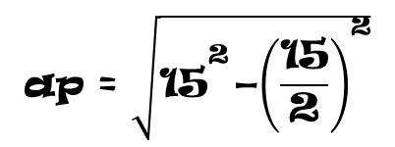
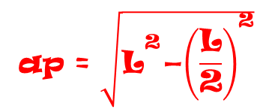
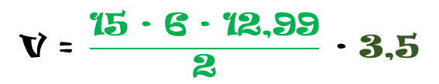
APPILED EXERCISES
A pool is shaped like a hexagonal prism. Its base is 15 m long and its height is 3.5 m. How much will it cost to fill it if the litre of water is at € 0.02?
Let’s graph the situation
It must be known what is the measure of the apothem of its base…
$$\text{ap} \text{=} \sqrt{{\text{L}}^{\text{2}}\text{−}{\left(\frac{\text{L}}{\text{2}}\right)}^{\text{2}}}$$
$$\text{ap} \text{=} \sqrt{{\text{15}}^{\text{2}}\text{−}{\left(\frac{\text{15}}{\text{2}}\right)}^{\text{2}}}$$
h = 3,5 m
ap ≈ 12.99 m
L = 15 m
$$\text{V} \text{=} \frac{\text{15} \text{∙} \text{6} \text{∙} \text{12,99}}{\text{2}} \text{∙} \text{3,5}$$
V = A_{b} × h
V = 2.045,92
Now, let’s calculate the cost of filling it…
Cost = (2.045,92)(0,02)
= 40,92

Slide 11
Now, surface areas formulas…

Slide 12
Surface area of solids
Any polyhedron
S = 2lh + 2wh + 2wl
Cylinder
S = 2πrh + 2πr²
Sphere
S = 4πr²
Cone
S = πr√r² + h²

Slide 13
Surface area of solids
The figure below shows a 2.5 m long concrete pipe section with an inner radius of 1.2m and thickness of 0.1m. Calculate its total surface area
The total surface area is given by…
S_{T} = S₁ − S₂
Let’s calculate each one of them…
S₁ = 2πr₁h₁ + 2πr₁²
2.5 m
= 2π(1.3 m)(2.5 m) + 2π(1.3 m)²
= 2π(3.25 m²) + 2π(1.69 m²)
B
= 2π(3.25 + 1.69)m²
S₂ = 2πr₂h₂ + 2πr₂²
= 2π(4.81)m²
= 2π(1.2 m)(2.5 m) + 2π(1.2 m)²
1.2 m
= 30.2221 m²
= 2π(3 m²) + 2π(1.44 m²)
= 2π(3 + 1.44)m²
0.1 m
= 2π(4.44)m²
= 27.8973 m²
S_{T} = 30.2221 m² − 27.8973 m²
= 2.3248 m²

Slide 14
Let’s see regular polyhedron…

Slide 15




REGULAR POLYHEDRON
$$\text{V} \text{=} \frac{\sqrt{\text{2}}}{\text{12}}{\text{a}}^{\text{3}}$$
a
$$\text{A}\text{t} \text{=} {\text{a}}^{\text{2}} \text{∙} \sqrt{\text{3}}$$
Tetrahedron
$$\text{V} \text{=} \frac{\sqrt{\text{2}}}{\text{3}}{\text{a}}^{\text{3}}$$
$$\text{A}\text{t} \text{=} \text{2} {\text{a}}^{\text{2}} \text{∙} \sqrt{\text{3}}$$
Octahedron

Slide 16
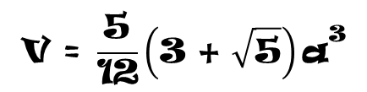
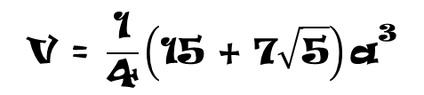

REGULAR POLYHEDRON
Dodecahedron
$$\text{V} \text{=} \frac{\text{1}}{\text{4}}\left(\text{15} \text{+} \text{7}\sqrt{\text{5}}\right){\text{a}}^{\text{3}}$$
A_{t} = 30 · a · ap
Icosahedron
$$\text{V} \text{=} \frac{\text{5}}{\text{12}}\left(\text{3} \text{+} \sqrt{\text{5}}\right){\text{a}}^{\text{3}}$$
$$\text{A}\text{t} \text{=} \text{5}\sqrt{\text{3} }\text{∙} {\text{a}}^{\text{2}}$$

