Slide 1




EXPONENTIAL AND LOGARITHMIC FUNCTIONS
By: Mr. Erick Duque
Contact us:
→ a.m.e.asesoriasmatematicas@gmail.com
→ asesoriasmatematicas0.webnode.com.co
→ @asesoriasmatematicas0
→ @a.m.e._asesorias_matematicas
→ Erick Duque

Slide 2
POWER
Power is an abbreviate multiplication
Let’s remember the elements of any power:
Exponent
5⁷ = 78,125
Base
Power

Slide 3
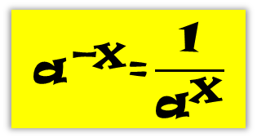

POWER
Some rules of the power are:
aº = 1
a¹ = a
a^{x} ∙ a^{y} = a^{x + y}
a^{x} ÷ a^{y} = a^{x – y}
(a^{x})^{y} = a^{x∙y}
a^{x} ∙ b^{x} = (a ∙ b)^{x}
$$\left({\text{a}}^{\frac{\text{x}}{\text{y}}}\right)\text{=}\sqrt[\text{y}]{{\text{a}}^{\text{x}}}$$
$${\text{a}}^{\text{−}\text{x}}\text{=}\frac{\text{1}}{{\text{a}}^{\text{x}}}$$
a^{x} ÷ b^{x} = (a ÷ b)^{x}

Slide 4
Let´s talk about logarithm…

Slide 5
LOGARITHM
Logarithm of any number is the exponent which that number must be raised to obtain the power.
Let’s remember the elements of the logarithm:
Argument
Log₅ 78,125 = 7
Logarithm
Base

Slide 6



LOGARITHMS
Logarithms carry out some rules. Some of them are shown below:
$$\text{log}{\frac{\text{a}}{\text{b}}\text{=}\text{log}{\text{a}}\text{−}\text{log}{\text{b}}}$$
Log (a ∙ b) = log a + log b
$$\text{log}{\sqrt[\text{n}]{\text{a}}}\text{=}\frac{\text{1}}{\text{n}}\text{∙}\text{log}{\text{a}}$$
Log a^{n} = n ∙ log a
Log_{a} a = 1
$${\text{log}}_{\text{c}}{\text{a}}\text{=}\frac{\text{log}{\text{a}}}{\text{log}{\text{c}}}$$

Slide 7
POWERS AND LOGARITHMS
It is said that there is a “love triangle” between Power, Logarithm and Radical
In the example below, we can understand better that proposal:
5⁷ = 78,125
⁷
√
78,125 = 5
Log₅ 78,125 = 7

Slide 8
EXPONENTIAL FUNCTION
A function is exponential if the variable is placed on the exponent
Mathematically, f(x) = a^{x}
That is: f(x) = 2^{x}

Slide 9
LOGARITHMIC FUNCTION
A function is logarithmic if the variable is placed on the argument
Mathematically, f(x) = log_{a} x; a > 0 and a ≠ 1
That is: f(x) = log₃ x

Slide 10
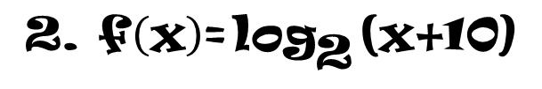
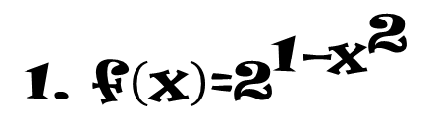
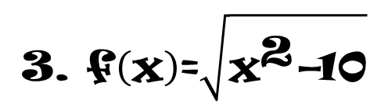
EXERCISES
To Practice
Plot the following functions:
$$\text{1}\text{. }\text{f}\left(\text{x}\right)\text{=}{\text{2}}^{\text{1}\text{−}{\text{x}}^{\text{2}}}$$
$$\text{2. }\text{f}\left(\text{x}\right)\text{=}{\text{log}}_{\text{2}}{\text{(}\text{x}\text{+}\text{1}\text{0)}}$$
$$\text{3. }\text{f}\left(\text{x}\right)\text{=}\sqrt{{\text{x}}^{\text{2}}\text{−}\text{1}\text{0}}$$
Email us your answer and you will receive your feedback

Slide 11
Let’s see some Word problems…

Slide 12
WORD PROBLEMS
Any problem of this type has the same structure.
First, you will find the known data
Second part is the applied function, f(x), either logarithmic or exponential.

Slide 13
WORD PROBLEMS
Example 1:
A radioactive substance initially emits a radiation of 120 units per hour. The disintegration of the substance could be written by the following function:
f(t) = 120 × (1/2)^{t},
where f(t) represents the number of unit radiation emitted per hour after t hours.
Calculate the table data for the domain 0 ≤ t ≤ 6
Sketch a graph to show the disintegration of the first six hours.

Slide 14
WORD PROBLEMS
It is necessary to do the corresponding calculations with the given function for this problem
f(t) = 120 × (1/2)^{t}
t
f(t) = y
0
120
1
60
f(1) = 120 ∙ (1/2)¹
30
= 120 ∙ (1/2)
2
= 60
3
15
4
7,5
5
3,75
The first value is given by the problem
for the second value, it must be replaced the literal “t” by 1
For the rest values must done the same as the second value and so on…
6
1,875

Slide 15
WORD PROBLEMS
Then, it must be used data of the table to graph in the Cartesian plane.

Slide 16
WORD PROBLEMS
Another example
Population P of certain city after t years is given by the formula:
P = 20,000∙e^{0.05t}
How many years have passed in the moment that the populations is 50,000 inhabitants?
Let´s see the solution
In this exercise, the 50,000 inhabitants represent the unknown P, and it must be found the variable t.
For the solution of that, it must be used the exponent definition shown in the “love triangle”.
The letter ‘e’ corresponds to Euler’s number which is equivalent to 2.718281…

Slide 17
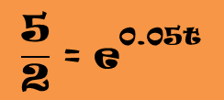
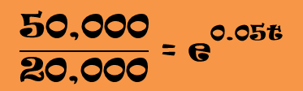
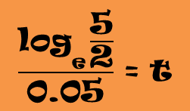


WORD PROBLEMS
It means:
20,000 passes to divide
50,000 = 20,000∙e^{0.05t}
$$\frac{\text{50}\text{,}\text{000}}{\text{20}\text{,}\text{000}} \text{=} {\text{e}}^{\text{0}\text{.}\text{05}\text{t}}$$
Apply logarithm in both sides of the equation
Simplify
$$\frac{\text{5}}{\text{2}} \text{=} {\text{e}}^{\text{0}\text{.}\text{05}\text{t}}$$
$${\text{log}}_{\text{e}}{\frac{\text{5}}{\text{2}} \text{=} {\text{log}}_{\text{e}}{{\text{e}}^{\text{0}\text{.}\text{05}\text{t}}}}$$
Apply a rule of the logarithms
Log_{e} e = 1
0.05 passes to divide
$${\text{log}}_{\text{e}}{\frac{\text{5}}{\text{2}} \text{=} \text{0}\text{.}\text{05}\text{t}}$$
$$\frac{{\text{log}}_{\text{e}}{\frac{\text{5}}{\text{2}}}}{\text{0}\text{.}\text{05}} \text{=} \text{t}$$
Do the calculation
≈ 18.326

Slide 18
Let’s see an important formula…

Slide 19
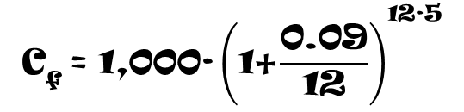
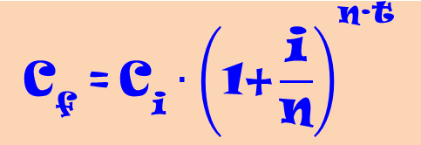

COMPOUND INTEREST
The following formula is so important:
$${\text{C}}_{\text{f}} \text{=} {\text{C}}_{\text{i}}{∙\left(\text{1}\text{+}\frac{\text{i}}{\text{n}}\right)}^{\text{n}\text{∙}\text{t}}$$
C_{f} = Final Capital
C_{i} = Initial Capital
i = interest rate
n = type period by years
t = Investment time
It is the formula of the compound interest.
Let’s see an example
Suppose, you invest $1,000 at a monthly compound interest rate of 9%. Calculate the cumulative amount after 5, 10 and 15 years.
C_{i} = $1,000
$${\text{C}}_{\text{f}} \text{=} \text{1}\text{,}\text{000∙}{\left(\text{1}\text{+}\frac{\text{0}\text{.}\text{09}}{\text{1}\text{2}}\right)}^{\text{1}\text{2∙5}}$$
$${\text{C}}_{\text{f}} \text{=} \text{1}\text{,}\text{000∙}{\left(\text{1}\text{.}\text{0075}\right)}^{\text{60}}$$
i = 9% = 0.09
n = 12
C_{f} = ?
C_{f} = 1,000 ∙ (1.56568)
t = 5, 10, 15
In the formula, each one of the known data must be replaced
C_{f} = 1,565.68

Slide 20
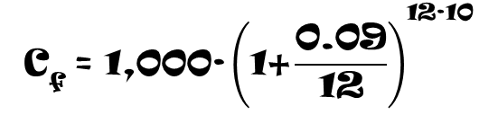

COMPOUND INTEREST
The following formula is so important:
$${\text{C}}_{\text{f}} \text{=} {\text{C}}_{\text{i}}{∙\left(\text{1}\text{+}\frac{\text{i}}{\text{n}}\right)}^{\text{n}\text{∙}\text{t}}$$
C_{f} = Final Capital
C_{i} = Initial Capital
i = interest rate
n = type period by years
t = Investment time
It is the formula of the compound interest.
Let’s see an example
Suppose, you invest $1,000 at a monthly compound interest rate of 9%. Calculate the cumulative amount after 5, 10 and 15 years.
C_{i} = $1,000
$${\text{C}}_{\text{f}} \text{=} \text{1}\text{,}\text{000∙}{\left(\text{1}\text{+}\frac{\text{0}\text{.}\text{09}}{\text{1}\text{2}}\right)}^{\text{1}\text{2∙}\text{1}\text{0}}$$
$${\text{C}}_{\text{f}} \text{=} \text{1}\text{,}\text{000∙}{\left(\text{1}\text{.}\text{0075}\right)}^{\text{1}\text{20}}$$
i = 9% = 0.09
n = 12
C_{f} = ?
C_{f} = 1,000 ∙ (2.45135)
t = 5, 10, 15
C_{f} = 2,451.35
For the rest values of ‘t’ must be done the same…

Slide 21
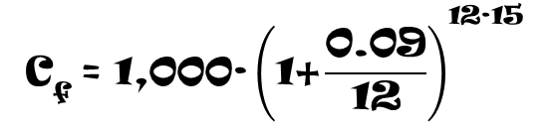

COMPOUND INTEREST
The following formula is so important:
$${\text{C}}_{\text{f}} \text{=} {\text{C}}_{\text{i}}{∙\left(\text{1}\text{+}\frac{\text{i}}{\text{n}}\right)}^{\text{n}\text{∙}\text{t}}$$
C_{f} = Final Capital
C_{i} = Initial Capital
i = interest rate
n = type period by years
t = Investment time
It is the formula of the compound interest.
Let’s see an example
Suppose, you invest $1,000 at a monthly compound interest rate of 9%. Calculate the cumulative amount after 5, 10 and 15 years.
C_{i} = $1,000
$${\text{C}}_{\text{f}} \text{=} \text{1}\text{,}\text{000∙}{\left(\text{1}\text{+}\frac{\text{0}\text{.}\text{09}}{\text{1}\text{2}}\right)}^{\text{1}\text{2∙}\text{1}\text{5}}$$
$${\text{C}}_{\text{f}} \text{=} \text{1}\text{,}\text{000∙}{\left(\text{1}\text{.}\text{0075}\right)}^{\text{1}\text{80}}$$
i = 9% = 0.09
n = 12
C_{f} = ?
C_{f} = 1,000 ∙ (3.83804)
t = 5, 10, 15
C_{f} = 3,838.04

Slide 22
WORD PROBLEMS
Let’s see another example
If a certain brand of dollars is bought in C dollars, its resale price, V (t), after t years, is given by:
V(t) = 0.78C ∙ (0.85)^{t - 1}
If the original cost is $ 10,000, calculate to the nearest dollar the value after: (a) 1 year, (b) 4 years, and (c) 6 years.
For the first year:
V(1) = 0.78 × 10,000 × (0.85)^{1 – 1}
V(1) = 7,800
For the second year value:
V(4) = 0.78 × 10,000 × (0.85)^{4 – 1}
V(4) ≈ 4,790
For the third year value:
V(6) = 0.78 × 10,000 × (0.85)^{6 – 1}
V(6) ≈ 3,461

Slide 23
PRACTICE EXERCISES
Sketch the graph of the following functions:
a) f(x) = 3^{x}
b) g(x) = (½)^{x}
c) h(x) = log_{¾} x
Solve the following problems:
1. A substance is disintegrated according to the following function:
Q(t) = 100(2)^{-t/5}
where Q(t) (in grams) is the current amount after ‘t’ years. What could the current amount be after 15 years?
2. The alcohol concentration in a person’s blood can be measured. Assuming than the risk R (given as a percent) of having an accident while driving a car can be modelled by the equation, R = 3e^{k·x}, where ‘x’ is the blood alcohol concentration and ‘k’ is a constant.
If a blood alcohol concentration of 0.06 results in a risk of 10% of having an accident, find the value of ‘k’
Using the obtained value of ‘k’, what is the risk of having an accident when the alcohol concentration in the blood is 0.17?

Slide 24
THE END
THE END

