Slide 1





QUADRATIC EQUATIONS
By Mr. Erick Duque
Contáctenos:
→ a.m.e.asesoriasmatematicas@gmail.com
→ asesoriasmatematicas0.webnode.com.co
→ @asesoriasmatematicas0
→ @a.m.e._asesorias_matematicas
→ Erick Duque

Slide 2
QUADRATIC EQUATION
Remember a quadratic equation is any equation of the form ax² + bx + c = 0.
The quadratic equations have two solutions and those are called “ROOTS”.
Any quadratic equation has two roots
There are two methods to solve quadratic equations:
Completing the square
Quadratic formula
ax² + bx + c = 0
It is necessary that the second literal must be the square root of the square literal

Slide 3
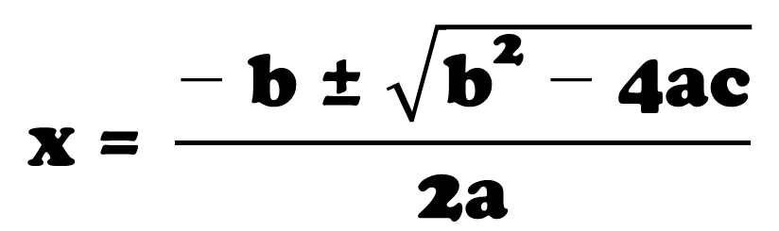
QUADRATIC EQUATION
QUADRATIC FORMULA:
ax² + bx + c = 0
← Here a, b, and c are number or coefficients, diferrent to zero
$$\text{x} \text{=} \frac{\text{−} \text{b} \text{±} \sqrt{{\text{b}}^{\text{2}} \text{−} \text{4}\text{ac}}}{\text{2}\text{a}}$$
The quadratic formula says →
If the sub-radical quantity is a negative number, you must write “NON REAL”

Slide 4
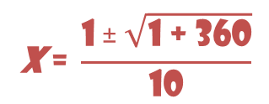
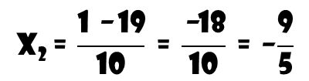
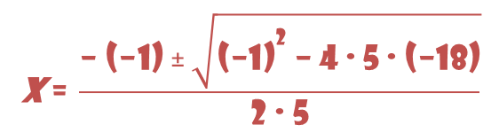
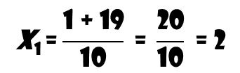
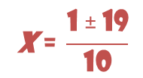
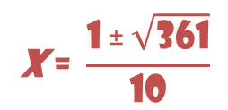
QUADRATIC EQUATION
Example 1: solve the following equation
5x² = 18 + x
1st: Rewrite the equation in the form ax² + bx + c = 0
5x² – x – 18 = 0
2nd: Identify the values of a, b, and c
a = 5
b = –1
c = – 18
3rd: replace the literals into the formula
$$\text{x}\text{ = }\frac{\text{−} \text{(−1)} \text{±} \sqrt{{\text{(−1)}}^{\text{2}} \text{−} \text{4} \text{∙} \text{5} \text{∙} \text{(−18)}}}{\text{2} \text{∙} \text{5}}$$
$$\text{x} \text{=} \frac{\text{1} \text{±} \sqrt{\text{1} \text{+} \text{360}}}{\text{10}}$$
$$\text{x} \text{=} \frac{\text{1} \text{±} \sqrt{\text{3}\text{61}}}{\text{10}}$$
$$\text{x} \text{=} \frac{\text{1} \text{±} \text{19}}{\text{10}}$$
$$\text{x}\text{1} \text{=}\frac{\text{1} \text{+} \text{19}}{\text{10}} \text{=} \frac{\text{20}}{\text{10}} \text{=} \text{2}$$
$$\text{x}\text{2} \text{=} \frac{\text{1} \text{−} \text{19}}{\text{10}} \text{=} \frac{\text{−}\text{18}}{\text{10}} \text{=} \text{−}\frac{\text{9}}{\text{5}}$$
Aquí salen las dos soluciones de la ecuación

Slide 5
Let practice some exercises

Slide 6
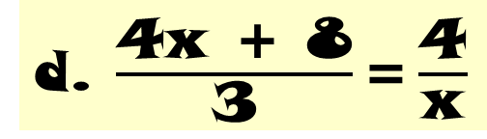
EXERCISES
Solve the following quadratic equations using the quadratic formula
a. 3x² – 4x = 6
b. w² – 3w = 0
c. 3h² – 24h + 48 = 0
d. $\frac{\text{4}\text{x} \text{+} \text{8}}{\text{3}}\text{=}\frac{\text{4}}{\text{x}}$
e. (y-2)(y-3) = 9y + 6
f. $\left[{\left(\text{x} \text{−} \text{1}\right)}^{\text{2}} \text{+} {\left(\text{x} \text{+} \text{1}\right)}^{\text{2}}\right] \text{∙} \left(\text{x} \text{+} \text{3}\right)\text{=(2}\text{x} \text{+} \text{9}\text{)}\text{(}\text{x} \text{+} \text{1)(}\text{x} \text{−} \text{1)}$
Send us your results and we return back your feedback

Slide 7
Let see another method…

Slide 8
COMPLETING THE SQUARE
The rule is simple: “divide by two and then squared”
1st step:
Leave the variables to one side of equation.
Take the second coefficient, divide it by 2 then the result is squared and add it in both sides of the equation.
2nd step:
3rd step:
factor the trinomial and solve the operations.
Pass the square to the other member of the equation and solve the equation.
4th step:

Slide 9
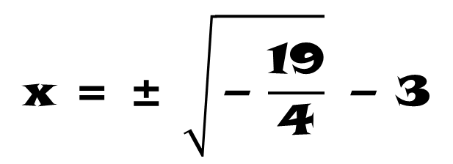
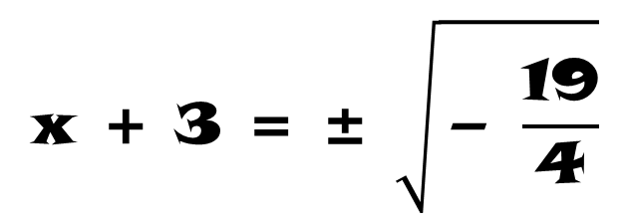
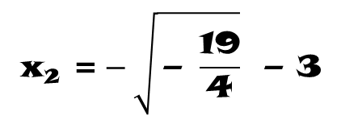
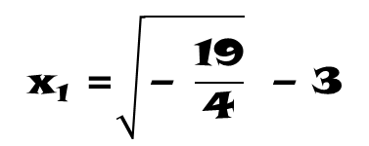
COMPLETING THE SQUARE
Solve the following equation using completing the square method
x² + 3x + 7 = 0
x² + 3x = –7
Keep the variables on one side of the equation
Apply the rule: take the second coefficient divide it by 2 then square it. Add this result to both sides of the equation,
x² + 3x
+ (3/2)²
= –7
+ (3/2)²
3 ÷ 2 = 3/2 → (3/2)²
(x + 3/2)² = –19/4
Factor the resulting trinomial using Perfect Square Trinomial
$$\text{x} \text{+} \text{3} \text{=} \text{±} \sqrt{\text{−} \frac{\text{19}}{\text{4}}}$$
Solve the resulting equation
$$\text{x}\text{1} \text{=}\sqrt{\text{−} \frac{\text{19}}{\text{4}}} \text{−} \text{3}$$
$$\text{x} \text{=} \text{±} \sqrt{\text{−} \frac{\text{19}}{\text{4}}} \text{−} \text{3}$$
No real solutions
$$\text{x}\text{2} \text{=}−\sqrt{\text{−} \frac{\text{19}}{\text{4}}} \text{−} \text{3}$$

Slide 10
Let practice some exercises

Slide 11
EXERCISES
Solve the following quadratic equations using completing the square method
x² – 10x + 19 = 0
t² + 12t + 42 = 0
5h² = –3h + 7
Send us your results and we return back your feedback

Slide 12
Let see some applications…

Slide 13


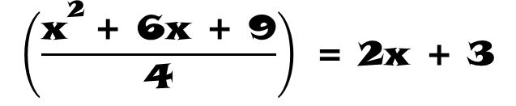
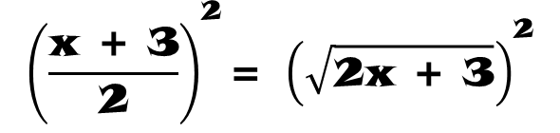
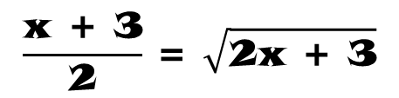
RADICAL EQUATIONS
It is usual when you solve some radical equations, to solve a quadratic equation
$$\text{2}\text{x} \text{+} \text{3} \text{=} \text{4}\sqrt{\text{2}\text{x} \text{+} \text{3}} \text{−} \text{3}$$
← This is an example of a radical equation
To solve any radical equation, the steps are:
1st: keep the radical expression alone on one side of the equation
$$\text{2}\text{x} \text{+} \text{3} \text{+} \text{3} \text{=} \text{4}\sqrt{\text{2}\text{x} \text{+} \text{3}}$$
Pass the independent term and simplify
$$\frac{\text{x} \text{+} \text{3}}{\text{2}} \text{=} \sqrt{\text{2}\text{x} \text{+} \text{3}}$$
2nd: Square both sides of the equation:
$${\left(\frac{\text{x} \text{+} \text{3}}{\text{2}}\right)}^{\text{2}}\text{=} {\left(\sqrt{\text{2}\text{x} \text{+} \text{3}}\right)}^{\text{2}}$$
Square both sides of the equation
$$\left(\frac{{\text{x}}^{\text{2}} \text{+} \text{6}\text{x} \text{+} \text{9}}{\text{4}}\right) \text{=} \text{2}\text{x} \text{+} \text{3}$$

Slide 14





RADICAL EQUATIONS
$${\text{x}}^{\text{2}} \text{+} \text{6}\text{x} \text{+} \text{9} \text{=} \text{4} \text{∙} \text{(2}\text{x} \text{+} \text{3)}$$
Multiply both terms, 2x and 3
$${\text{x}}^{\text{2}} \text{+} \text{6}\text{x} \text{+} \text{9} \text{=} \text{8}\text{x} \text{+} \text{12}$$
$${\text{x}}^{\text{2}} \text{+} \text{6}\text{x} \text{+} \text{9} \text{−} \text{8}\text{x} \text{−} \text{12} \text{=} \text{0}$$
$${\text{x}}^{\text{2}} \text{−} \text{2}\text{x} \text{−} \text{3} \text{=} \text{0}$$
3rd: solve the resulting equation.
(x $\text{−}$ 3)(x + 1) = 0
(x – 3) = 0
or
(x + 1) = 0
If a product is equal to zero, it means one of them could be zero
x = 3
x = – 1

Slide 15
Let solve some exercises…

Slide 16



EXERCISES
Solve the following quadratic equations using completing the square method
$$\sqrt{\text{2}\text{x} \text{−} \text{1} }\text{=} \text{5}$$
$$\sqrt{\text{x} \text{−} \text{8}} \text{=} \sqrt{\text{3}\text{x} \text{+} \text{3}}$$
$$\text{1} \text{−} \sqrt{\text{x} \text{+} \text{2} }\text{=} \sqrt{\text{2}\text{x} \text{+} \text{5}}$$
Send us your results and we return back your feedback

Slide 17

THE END

