Slide 1




Present
GROUPED DATA
By: Mr. Erick Duque
Contact us:
→ a.m.e.asesoriasmatematicas@gmail.com
→ asesoriasmatematicas0.webnode.com.co
→ @asesoriasmatematicas0
→ @a.m.e._asesorias_matematicas
→ Erick Duque

Slide 2
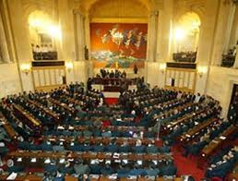

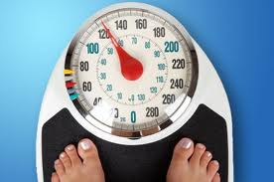
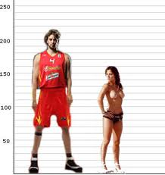
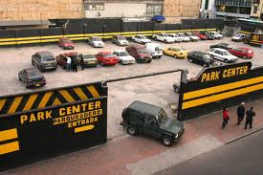
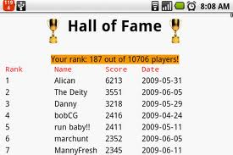
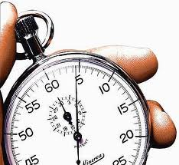
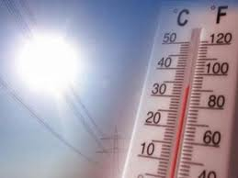
GROUPED DATA
DATA
DATA
Discrete Data
Continuous Data
can’t be measured but it can be counted
can’t be counted but they can be measured.

Slide 3
Let´s classify some data…

Slide 4
PRACTICE
Classify the following data into discrete (D) or Continuous (C)
C
The heights of a set of bonsais
The shoes sizes of the rugby team.
D
The number of hats of different colours in a showcase.
D
Baby chimpanzees weights.
C
The students’ time taken for them to complete an English essay.
C
The score of a French test.
D
D
The obtained score by throwing a dart 50 times.
The time taken by students of ten year walking from soccer field to their classroom.
C
The number of visitors to the Niagara Falls.
D

Slide 5
Let´s see how to construct tables…

Slide 6
FREQUENCY TABLES
1st step:
find the range (R) of the data. It is the difference between the maximum data and the minimum data.
Use the following formula to do that
R = V_{max} – V_{min}
2nd Step:
find the number of class intervals.
Use the following formula to do that
Number of Classes = R ÷ length of class-intervals
find the length of class intervals.
Use the following formula to do that
length of Class-intervals = R ÷ Number of intervals

Slide 7
FREQUENCY TABLES
3rd step:
Construct the table with the following items.
Class
Class limits
Middle point
Absolute frequency
(f)
Cumulative absolute frequency
(f_{i})
Relative frequency
(F)
Cumulative relative frequency
(F_{r})
Add and subtract 0.5 to the class value
Add both, the maximum and minimum of the class interval and then divide by 2
It is the sum of each and every one of the absolute frequencies for all equal events or earlier than a value.

Slide 8
Let´s see how to show data in graphs…

Slide 9
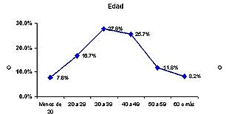
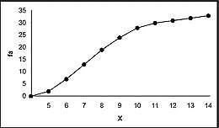
GRAPHS
Histogram
Frequency polygon
Frequencies
Frequencies
Class-intervals
Class-intervals
Relative frequency polygon
Cumulative frequency

Slide 10
Let´s see some examples…

Slide 11
EXERCISES
Exercise 1
The scores of 50 students have been collected by their teacher on a math test. The results are shown bellow.
8 | 52 | 38 | 48 | 42 | 9 | 15 | 36 | 36 | 53
10 | 8 | 46 | 46 | 9 | 11 | 12 | 24 | 49 | 34
10 | 11 | 9 | 11 | 45 | 25 | 25 | 37 | 14 | 16
20 | 22 | 12 | 43 | 36 | 23 | 23 | 26 | 27 | 16
21 | 29 | 38 | 30 | 47 | 34 | 39 | 48 | 46 | 48
Construct the frequency table with 7 class-intervals.

Slide 12
EXERCISES
solution
Range
R = 53 – 8 = 45
Class-interval
7
Length of Class-interval
45 ÷ 7 ≈ 6.4 → 6
Now, it is the time to construct the table, in which data are going to show…

Slide 13
EXERCISES
solution
Constructing the table
Class | Class limits | Midpoint | f | fi | F | Fr
8 | 8 – 14 | 11 | 13 | 13 | 0.26 | 0.26
15 | 15 – 21 | 18 | 5 | 18 | 0.10 | 0.36
22 | 22 – 28 | 25 | 8 | 26 | 0.16 | 0.52
29 | 29 – 35 | 32 | 5 | 31 | 0.10 | 0.62
36 | 36 – 42 | 39 | 8 | 39 | 0.16 | 0.78
43 | 43 – 49 | 46 | 9 | 48 | 0.18 | 0.96
50 | 50 – 56 | 53 | 2 | 50 | 0.04 | 1
Totals |  |  | 50 |  | 1

Slide 14
EXERCISES
It is measured 75 students, in centimetres, in a school. The results are shown bellow
Exercise 2
175 156 172 159 161 185 186 192 179 163 164 170 164 167 168 174 172 168 176 166 167 169 182 170 169 167 170 162 172 171 174 171 155 171 171 170 157 170 173 173 174 168 166 172 172 158 159 163 163 168 174 175 150 154 175 160 175 177 178 180 169 165 180 166 184 183 174 173 162 185 189 169 173 171 173
Construct the frequency table with 8 class-intervals.

Slide 15
EXERCISES
solution
Range
R = 192 – 150 = 42
Class-interval
8
Length of Class-interval
42 ÷ 8 = 5,25 ≈ 5
Now, it is the time to construct the table, in which data are going to show…

Slide 16
EXERCISES
solution
Constructing the table
Class
Class limit
Midpoint
f
fi
F
Fr
150 – 155
149.5 – 155.5
152.5
3
3
0.040
0.040
156 – 161
155.5 – 161.5
158.5
7
10
0.093
0.133
162 – 167
161.5 – 167.5
164.5
14
24
0.187
0.320
168 – 173
167.5 – 173.5
170,5
28
52
0.373
0.693
174 – 179
173.5 – 179.5
176.5
13
65
0.173
0.867
180 – 185
179.5 – 185.5
182.5
7
72
0.093
0.960
186 – 191
185.5 – 191.5
188.5
2
74
0.027
0.987
192 – 197
191.5 – 197.5
194.5
1
75
0.013
1
Totals
75
1

Slide 17
Let´s practice at home…

Slide 18
PRACTICE
Exercise 1
Data show the weights of 80 people, in kilograms.
60, 66, 77, 70, 66, 68, 57, 70, 66, 52, 75, 65, 69, 71, 58, 66, 67, 74, 61, 63, 69, 80, 59, 66, 70, 67, 78, 75, 64, 71, 81, 62, 64, 69, 68, 72, 83, 56, 65, 74, 67, 54, 65, 65, 69, 61, 67, 73, 57, 62, 67, 68, 63, 67, 71, 68, 76, 61, 62, 63, 76, 61, 67, 67, 64, 72, 64, 73, 79, 58, 67, 71, 68, 59, 69, 70, 66, 62, 63, 66,
Distribute the data in 5 intervals.
Calculate the percentage of people less tan 65 Kg.
How many people have weight greater or equal of 70 Kg. but less than 85kg?

Slide 19
PRACTICE
Exercise 2
50 couples have surveyed regarding their number of children and the following data were obtained:
2 , 4 , 2 , 3 , 1 , 2 , 4 , 2 , 3 , 0 , 2 , 2 , 2 , 3 , 2 , 6 , 2 , 3, 2, 2, 3, 2, 3, 3, 4,1 , 3 , 3 , 4 , 5 , 2 , 0 , 3 , 2 , 1, 2, 3, 2, 2, 3, 1 , 4 , 2 , 3 , 2 , 4 , 3 , 3 , 2
Construct the corresponding frequency table and graph them.
Send us your answers and you will receive your feedback

Slide 20
Let´s see statistical measures…

Slide 21
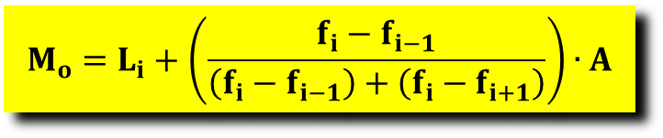
MEASURE OF CENTRAL TENDENCY
Mode
This is the most frequent class in a set of data.
In order to calculate, it is used the following formula:
$$M_{o}=L_{i}+\left(\frac{f_{i}−f_{i−1}}{\left(f_{i}−f_{i−1}\right)+\left(f_{i}−f_{i+1}\right)}\right)∙A$$
Where, L_{i} is the lower of median class, f_{i} is the absolute frequency, f_{i-1} means the preceding absolute frequency f_{i+1} is the following absolute frequency and A is the interval amplitude

Slide 22
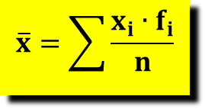

MEASURE OF CENTRAL TENDENCY
Mean:
This is the average in a set of data. Its symbol is $\overline{x}$
In order to calculate, it is used the following formula:
$$\overline{x}=\sum{\frac{x_{i}∙f_{i}}{n}}$$
Where, x_{i} is the middle point of the class, f_{i} is the absolute frequency of the class, and n is the number of collected data.

Slide 23
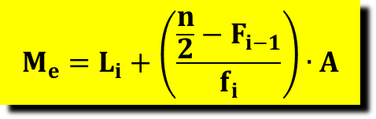
MEASURE OF CENTRAL TENDENCY
Median:
This is the middle item of a set of data.
In order to calculate it, it is used the following formula:
$$M_{e}=L_{i}+\left(\frac{\frac{n}{2}−F_{i−1}}{f_{i}}\right)∙A$$
Where, L_{i} is the lower of median class, f_{i} is the absolute frequency of the median interval, F_{i-1} means the preceding cumulative absolute frequency, n is the total data and A is the interval amplitude

Slide 24
MEASURE OF CENTRAL TENDENCY
Example:
It is consulting a group of 50 people about their ages and the results are shown bellow:
38, 15, 10, 12, 62, 46, 25, 56, 27, 24, 23, 21, 20, 25, 38, 27, 48, 35, 50, 65, 59, 58, 47, 42, 37, 35, 32, 40, 28, 14, 12, 24, 66, 73, 72, 70, 68, 65, 54, 48, 34, 33, 21, 19, 61, 59, 47, 46, 30, 30.
Construct
the frequency table for this data in 7 classes
find its mode, mean and median

Slide 25
MEASURE OF CENTRAL TENDENCY
Solution:
38, 15, 10, 12, 62, 46, 25, 56, 27, 24, 23, 21, 20, 25, 38, 27, 48, 35, 50, 65, 59, 58, 47, 42, 37, 35, 32, 40, 28, 14, 12, 24, 66, 73, 72, 70, 68, 65, 54, 48, 34, 33, 21, 19, 61, 59, 47, 46, 30, 30.
Range
73
-
10
=
63
Class-interval
63
÷
7
=
9
Class limits | Midpoint | f | fi | F | Fr
10 – 19 | 14.5 | 5 | 5 | 0.1 | 0.1
19 – 28 | 23.5 | 11 | 16 | 0.22 | 0.32
28 –37 | 32.5 | 8 | 24 | 0.16 | 0.48
27 – 46 | 41.5 | 5 | 29 | 0.10 | 0.58
46 – 55 | 50.5 | 8 | 37 | 0.16 | 0.74
55 – 64 | 59.5 | 6 | 43 | 0.12 | 0.86
64 – 73 | 68.5 | 7 | 50 | 0.14 | 1
Totals |  | 50 |  | 1

Slide 26

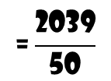
MEASURE OF CENTRAL TENDENCY
Solution:
Class limits | Midpoint | f | fi | F | Fr
10 – 19 | 14.5 | 5 | 5 | 0.1 | 0.1
19 – 28 | 23.5 | 11 | 16 | 0.22 | 0.32
28 –37 | 32.5 | 8 | 24 | 0.16 | 0.48
27 – 46 | 41.5 | 5 | 29 | 0.10 | 0.58
46 – 55 | 50.5 | 8 | 37 | 0.16 | 0.74
55 – 64 | 59.5 | 6 | 43 | 0.12 | 0.86
64 – 73 | 68.5 | 7 | 50 | 0.14 | 1
Totals |  | 50 |  | 1
Mean:
$$\overline{x}=\sum{\frac{x_{i}∙f_{i}}{n}}$$
$$\overline{\text{x}}\text{=}\frac{\left(\text{14.5}\text{∙5}\right)\text{+}\left(\text{23.5∙11}\right)\text{+}\left(\text{32.5∙8}\right)\text{+}\left(\text{41.5∙5}\right)\text{+}\left(\text{50.5∙8}\right)\text{+}\left(\text{59.5∙6}\right)\text{+(68.5∙7)}}{\text{50}}$$
$$\text{=}\frac{\text{2039}}{\text{50}}$$
= 40.78

Slide 27
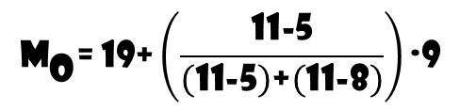

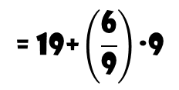
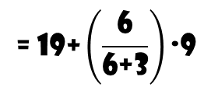
MEASURE OF CENTRAL TENDENCY
Solution:
Class limits | Midpoint | f | fi | F | Fr
10 – 19 | 14.5 | 5 | 5 | 0.1 | 0.1
19 – 28 | 23.5 | 11 | 16 | 0.22 | 0.32
28 –37 | 32.5 | 8 | 24 | 0.16 | 0.48
27 – 46 | 41.5 | 5 | 29 | 0.10 | 0.58
46 – 55 | 50.5 | 8 | 37 | 0.16 | 0.74
55 – 64 | 59.5 | 6 | 43 | 0.12 | 0.86
64 – 73 | 68.5 | 7 | 50 | 0.14 | 1
Totals |  | 50 |  | 1
Mode
$$M_{o}=L_{i}+\left(\frac{f_{i}−f_{i−1}}{\left(f_{i}−f_{i−1}\right)+\left(f_{i}−f_{i+1}\right)}\right)∙A$$
$${\text{M}}_{\text{o}}\text{= 19+}\left(\frac{\text{11−5}}{\left(\text{11−5}\right)\text{+}\left(\text{11−8}\right)}\right)\text{∙9}$$
$$\text{= 19+}\left(\frac{\text{6}}{\text{6+3}}\right)\text{∙9}$$
$$\text{= 19+}\left(\frac{\text{6}}{\text{9}}\right)\text{∙9}$$
= 25

Slide 28
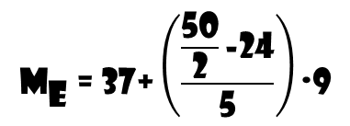

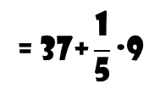
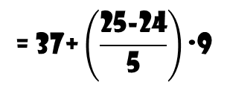
MEASURE OF CENTRAL TENDENCY
Solution:
Class limits | Midpoint | f | fi | F | Fr
10 – 19 | 14.5 | 5 | 5 | 0.1 | 0.1
19 – 28 | 23.5 | 11 | 16 | 0.22 | 0.32
28 –37 | 32.5 | 8 | 24 | 0.16 | 0.48
37 – 46 | 41.5 | 5 | 29 | 0.10 | 0.58
46 – 55 | 50.5 | 8 | 37 | 0.16 | 0.74
55 – 64 | 59.5 | 6 | 43 | 0.12 | 0.86
64 – 73 | 68.5 | 7 | 50 | 0.14 | 1
Totals |  | 50 |  | 1
$$M_{e}=L_{i}+\left(\frac{\frac{n}{2}−F_{i−1}}{f_{i}}\right)∙A$$
Median:
$${\text{M}}_{\text{e}} \text{= 37+}\left(\frac{\frac{\text{50}}{\text{2}}\text{−24}}{\text{5}}\right)\text{∙9}$$
$$\text{= 37+}\left(\frac{\text{25−24}}{\text{5}}\right)\text{∙9}$$
$$\text{= 37+}\frac{\text{1}}{\text{5}}\text{∙9}$$
= 38.8

Slide 29
Let´s see another measures…

Slide 30
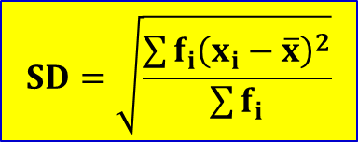
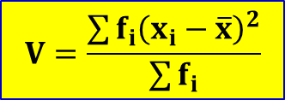
MEASURES OF SPREAD
Variance
The variance is a measure of variability.
Variance tells you the degree of spread in your data set. The more spread the data, the larger the variance is in relation to the mean.
$$V=\frac{\sum{f_{i}{\left(x_{i}−\overline{x}\right)}^{2}}}{\sum{f_{i}}}$$
standar deviation
The standard deviation is derived from variance and tells you, on average, how far each value lies from the mean. It’s the square root of variance.
$$SD=\sqrt{\frac{\sum{f_{i}{\left(x_{i}−\overline{x}\right)}^{2}}}{\sum{f_{i}}}}$$

Slide 31
MEASURES OF SPREAD
Constructing the table
The following set of data are test results obtained by a group of students in two test which the maximum mark was 20.
Test 1
4 12 11 10 5 10 12 12 6 8 19 13 3
7 11 13 4 9 12 10 6 13 19 11 3 12
11 6 13 16 11 5 10 12 13 7 8 13
14 6 10 12 10 7 10 12 10
Test 2
9 8 10 10 8 9 10 11 8 8 11 10 9
8 11 10 9 8 10 11 8 9 11 10 9 8
11 11 9 9 11 10 8 9 11 10 8 9 11
11 8 8 11 10 8 9 10 10

Slide 32
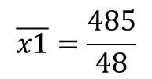
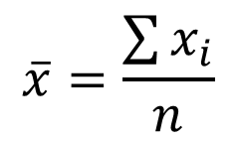

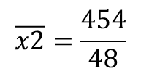

MEASURES OF SPREAD
First, let’s calculate the mean of both set of data
$$\overline{x}=\frac{\sum{x_{i}}}{n}$$
Test 1.
$$\overline{x1}=\frac{485}{48}$$
$$=10,1$$
Test 2.
$$\overline{x2}=\frac{454}{48}$$
$$=9,5$$
To calculate the variance of a set of data, the frequency table can be extended as follows
Mark
Frequency
Mark – mean
f x (Mark – mean)²

Slide 33
MEASURES OF SPREAD
Mark | f | Mean | Mark - mean | f ⋅ (Mark - mean)²
3 | 2 | 10,1 | -7,10 | 100,82
4 | 2 | 10,1 | -6,10 | 74,42
5 | 2 | 10,1 | -5,10 | 52,02
6 | 4 | 10,1 | -4,10 | 67,24
7 | 3 | 10,1 | -3,10 | 28,83
8 | 2 | 10,1 | -2,10 | 8,82
9 | 1 | 10,1 | -1,10 | 1,21
10 | 8 | 10,1 | -0,10 | 0,08
11 | 5 | 10,1 | 0,90 | 4,05
12 | 8 | 10,1 | 1,90 | 28,88
13 | 6 | 10,1 | 2,90 | 50,46
14 | 2 | 10,1 | 3,90 | 30,42
15 | 0 | 10,1 | 4,90 | 0,00
16 | 1 | 10,1 | 5,90 | 34,81
17 | 0 | 10,1 | 6,90 | 0,00
18 | 0 | 10,1 | 7,90 | 0,00
19 | 2 | 10,1 | 8,90 | 158,42
 |  |  | Total (Σ) | 640,48

Slide 34

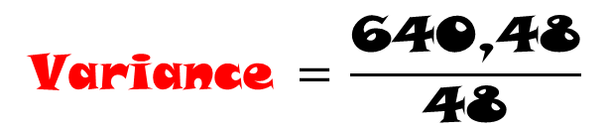
MEASURES OF SPREAD
The total is divided by the number of the data (48) in order to obtain the variance of the marks
$$\text{Variance} \text{= }\frac{\text{640,48}}{\text{48}}$$
= 13,34
If we used the square root of the variance, we obtain the standard deviation
standard deviation
$$\text{= }\sqrt{\text{13,34 }}\text{= 3,65}$$

Slide 35

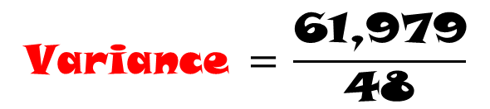
MEASURES OF SPREAD
Test 2.
Mark | F | Mean | Mark - mean | f ⋅ (Mark - mean)²
8 | 13 | 9,5 | -1,48 | 28,475
9 | 11 | 9,5 | -0,48 | 2,534
10 | 12 | 9,5 | 0,52 | 3,245
11 | 12 | 9,5 | 1,52 | 27,725
 |  |  | Total | 61,979
$$\text{Variance} \text{= }\frac{\text{61,979}}{\text{48}}$$
= 1,291
standard deviation
$$\text{= }\sqrt{\text{1,291 }}\text{= 1,136}$$

Slide 36
Let´s see another statistical measures…

Slide 37
STATISTICAL MEASURES
quartile
Quartiles are three values that split sorted data into four parts, each with an equal number of observations.
PERCENTILE
A percentile is a value with a certain percentage of the data falling below it. In general terms, k% of the data falls below the kth percentile.
outliers
Outliers are observations that are extremely high or low. One definition of an outlier is any observation that is more than 1.5 IQR away from the first or third quartile.

Slide 38
Let´s see an example…

Slide 39
STATISTICAL MEASURES
Example:
you conducted a small study on language development in children 1–6 years old. You’re writing a paper about the study and you want to report the quartiles of the children’s ages.
age (years) | 1 | 2 | 3 | 4 | 5 | 6
Frequency | 2 | 3 | 4 | 1 | 2 | 2
2+3+4+1+2+2 =
14
Answer:
1.
Find the total of data set.
2.
Sort data from less to greater
1 1 2 2 2 3 3 3 3 4 5 5 6 6
3.
Find the mean of data set.
Mean = 3 ← it is Q2
4.
Find the mean of the left side of the mean
Mean = 2 ← Q1
5.
Find the mean of the right side of the mean
Mean = 2 ← Q3

Slide 40
Let´s learn how to plot…

Slide 41
BOXPLOT
1.
Draw a straight line with marks.
2.
Place the quartiles on the rec.
3.
Make the box.
4.
Place the minimum and maximum
Q1
Q2
Q3
2
3
5

