Slide 1

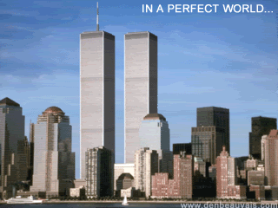



CONIC SECTIONS
By: Mr. Erick Duque Barragán
Contact us:
→ a.m.e.asesoriasmatematicas@gmail.com
→ asesoriasmatematicas0.webnode.com.co
→ @asesoriasmatematicas0
→ @a.m.e._asesorias_matematicas
→ Erick Duque

Slide 2
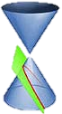
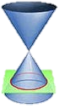
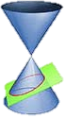
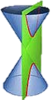
CONIC SECTIONS
Parabola
Circle
Ellipse
Hyperbola
The conics are the intersection of the cone with a plane.

Slide 3
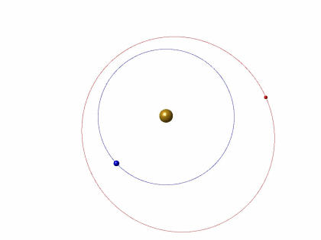
CIRCLE
The circle are all points that are at the same distance (radius) from a fixed point (centre)

Slide 4
CIRCLE
The equation of the circle with centre in (0, 0) is:
4
X² + y² = r²
3
2
•
1
(h, k)
•
1
–3
–2
–1
2
3
–1
–2
–3
The equation of the circle, with centre in (h, k) is:
(x – h)² + (y – k)² = r²

Slide 5
ELLIPSE
The ellipse is the set of points such that the sum of the distances to two fixed points, called foci, is constant.
The elements of the ellipse are:
‧
‧
‧
‧
‧
Minor axis
Major axis
‧
Vertex
Focus

Slide 6
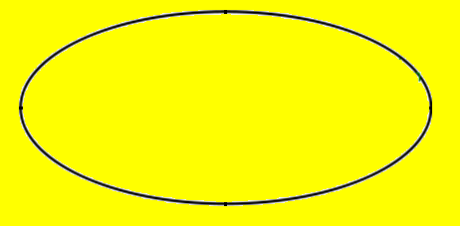
ELLIPSE
The equation of the ellipse with centre in (0, 0) is:
Y
x²
y²
+
=
1
a²
b²
(0, b)
‧
‧
X
(-a, 0)
(-c, 0)
(c, 0)
(a, 0)
(0, -b)
c² = a² – b²
Ellipse lying on
That happen when a > b

Slide 7
ELLIPSE
The equation of the ellipse with centre in (0, 0) is:
Y
•
(0, b)
x²
y²
+
=
1
•
(0, c)
b²
a²
X
•
•
(–a, 0)
(a, 0)
(0, –c)
c² = a² – b²
•
•
(0, –b)
Ellipse standing up
That happen when b > a

Slide 8
ELLIPSE
The equation of the ellipse with centre in (h, k) is:
Y
(x – h)²
(y – k)²
+
=
1
(0, b + k)
a²
b²
•
(–c – h, 0)
(h + c, 0)
•
•
•
•
(–a – h, 0)
(h + a, 0)
X
•
(0, – b – k)
Ellipse lying on
That happen when a > b

Slide 9
ELLIPSE
The equation of the ellipse with centre in (h, k) is:
•
(0, b + k)
Y
•
(x – h)²
(y – k)²
(0, c + k)
+
=
1
b²
a²
•
•
(–a – h, 0)
(a + h, 0)
X
(0, –c – k)
•
•
(0, –b – k)
Ellipse standing up
That happen when b > a

Slide 10




HYPERBOLA
The hyperbola is the set of points such that the difference of the distances to two fixed points, called foci, is constant.
The elements of the hyperbola are:
$$F_{2}$$
•
•
Focus
$$V_{2}$$
•
•
Center
Focus
$$F_{1}$$
$$V_{1}$$
•

Slide 11
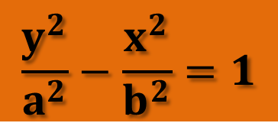
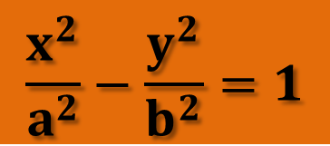

HYPERBOLA
The equation of the hyperbola which center is (0, 0) is:
$$\frac{x^{2}}{a^{2}}−\frac{y^{2}}{b^{2}}=1$$
Hyperbola lying on
The equation of the hyperbola which center is (0, 0) is:
$$\frac{y^{2}}{a^{2}}−\frac{x^{2}}{b^{2}}=1$$
Hyperbola standing up
$$b^{2}=c^{2}−a^{2}$$

Slide 12
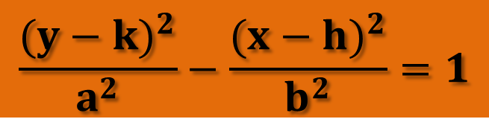
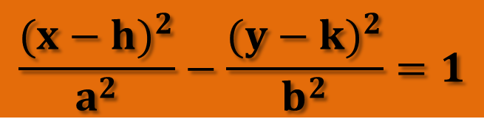

HYPERBOLA
The equation of the hyperbola which center is (h, k) is:
$$\frac{{(x−h)}^{2}}{a^{2}}−\frac{({y−k)}^{2}}{b^{2}}=1$$
Hyperbola lying on
The equation of the hyperbola which center is (h, k) is:
$$\frac{{(y−k)}^{2}}{a^{2}}−\frac{({x−h)}^{2}}{b^{2}}=1$$
Hyperbola standing up
$$b^{2}=c^{2}−a^{2}$$

Slide 13








PARABOLA
The parabola is the set of points such that they equidistant from a straight line (axis or directrix) and a fixed point called focus
$$y^{2}=4ax$$
← Open to the right and center (0, 0)
$$y^{2}=−4ax$$
← Open to the left and center (0, 0)
$$x^{2}=4ay$$
← Open upward and center (0, 0)
$$x^{2}=−4ay$$
← Open downward and center (0, 0)
$${(y−k)}^{2}=4a(x−h)$$
← Open to the right and center (h, k)
$${(y−k)}^{2}=−4a(x−h)$$
← Open to the left and center (h, k)
$${(x−h)}^{2}=4a(y−k)$$
← Open upward and center (h, k)
$${(x−h)}^{2}=−4a(y−k)$$
← Open downward and center (h, k)

Slide 14



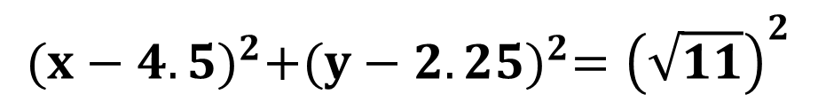
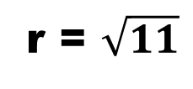
EXERCISES
Find the equation of the circle with center (4.5, 2.25) and radius $\sqrt{11}$
$${(x−h)}^{2}+{(y−k)}^{2}=r^{2}$$
h = 4.5
k = 2.25
r = $\sqrt{11}$
$${(x−4.5)}^{2}+{(y−2.25)}^{2}={\left(\sqrt{11}\right)}^{2}$$
$${(x−4.5)}^{2}+{(y−2.25)}^{2}=11$$
← The final equation
Replace into that equation the known values
First identify the equation to use

Slide 15


EXERCISES
Find the center and the radius of the equation:
$$x^{2}+y^{2}+2x+4y=11$$
$${(x}^{2}+2x )+{(y}^{2}+4y )=11$$
+1
+4
+ 1 + 4
$${(x+1)}^{2}+{(y+2)}^{2}=16$$
h = –1
k = –2
r = 4
Second, complete the square and add it at both sides of the equation
First, associate the term in x and y

