Slide 1




Presents
ALGEBRAIC FRACTIONS
ALGEBRAIC FRACTIONS
By: Mr. Erick Duque
Contact us:
→ a.m.e.asesoriasmatematicas@gmail.com
→ asesoriasmatematicas0.webnode.com.co
→ @asesoriasmatematicas0
→ @a.m.e._asesorias_matematicas
→ Erick Duque

Slide 2
First, the definition…

Slide 3
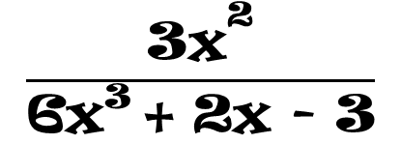

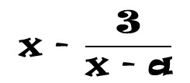
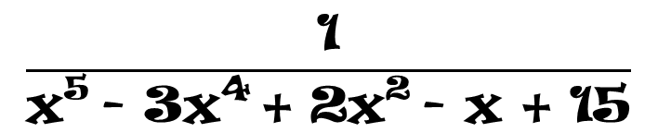
ALGEBRAIC FRACTIONS
Any expression in which the denominator has a variable, it is called “algebraic fraction”
$$\frac{\text{x}}{\text{y}}$$
$$\frac{\text{3}{\text{x}}^{\text{2}}}{\text{6}{\text{x}}^{\text{3}} \text{+ 2}\text{x}\text{ − 3}}$$
$$\frac{\text{1}}{{\text{x}}^{\text{5}} \text{− 3}{\text{x}}^{\text{4}} \text{+ 2}{\text{x}}^{\text{2}} \text{− }\text{x}\text{ + 15}}$$
As a fractions in arithmetic, algebraic fractions could be mixed
$$\text{x}\text{ − }\frac{\text{3}}{\text{x}\text{ − }\text{a}}$$
Example of mixed fraction

Slide 4
Now, let’s see the simplification…

Slide 5
SIMPLIFY ALGEBRAIC FRACTIONS
The rule to simplify algebraic fractions is simple:
Simplify monomials with monomial, binomials with binomials, trinomials with trinomials and polynomials with polynomials.
8a²b⁵
In that case, both numerator and denominator are monomials.
Example:
=
4
a
b²
2ab³
Subtract its exponents…
Simplify the numbers first…
Simplify the literals…

Slide 6
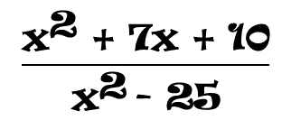
SIMPLIFY ALGEBRAIC FRACTIONS
But, what happen if the expressions are not monomial?
$$\frac{{\text{x}}^{\text{2}}\text{ + 7}\text{x}\text{ + 10}}{{\text{x}}^{\text{2}} \text{− 25}}$$
For example this expression:
The process is vey simple:
1st Step
Factor each term of the fraction
Apply the rule studied. Monomials with monomials, binomials with binomials, trinomials with trinomials and polynomials with polynomials
2nd Step

Slide 7
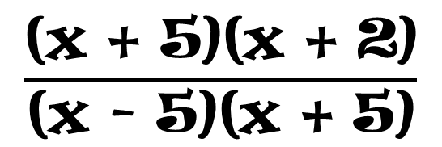
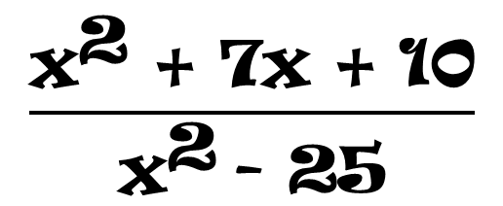

SIMPLIFY ALGEBRAIC FRACTIONS
1st Step
2nd Step
$$\frac{{\text{x}}^{\text{2}}\text{ + 7}\text{x}\text{ + 10}}{{\text{x}}^{\text{2}} \text{− 25}}$$
$$\frac{\text{(}\text{x}\text{ + 5)(}\text{x}\text{ + 2)}}{\text{(}\text{x}\text{ − 5)(}\text{x}\text{ + 5)}}$$
Perfect square trinomial
Difference of two squares
$$\frac{\text{(}\text{x}\text{ + 2)}}{\text{(}\text{x}\text{ − 5)}}$$
Then simplify using the rule studied

Slide 8
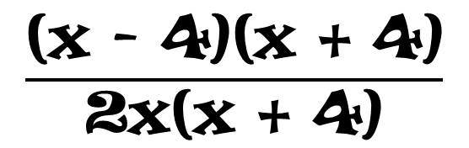
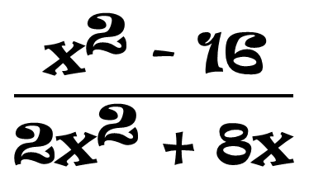

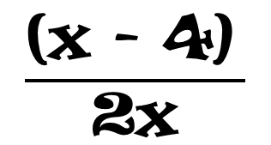
SIMPLIFY ALGEBRAIC FRACTIONS
1st Step
2nd Step
$$\frac{{\text{x}}^{\text{2}}\text{ − 16}}{\text{2}{\text{x}}^{\text{2}}\text{ + 8}\text{x}}$$
$$\frac{\text{(}\text{x}\text{ − 4)(}\text{x}\text{ + 4)}}{\text{2}\text{x}\text{(}\text{x}\text{ + 4)}}$$
Difference of two squares
Common factor
$$\frac{\text{(}\text{x}\text{ − 4)} }{\text{2}\text{x}}$$
$$\frac{\text{12}{\text{a}}^{\text{2}}{\text{b}}^{\text{7}}}{\text{60}{\text{a}}^{\text{3}}{\text{b}}^{\text{5}}\text{c}}$$
5
b²
=
a
c
Now, try to some solve exercises

Slide 9
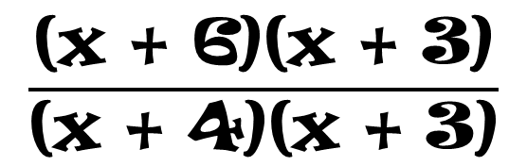
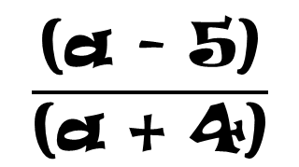
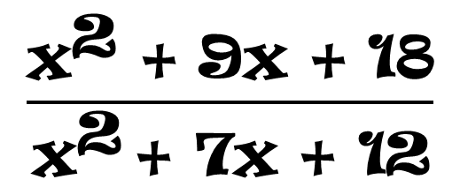
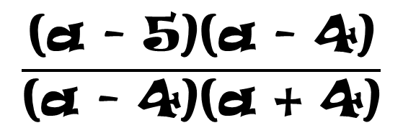
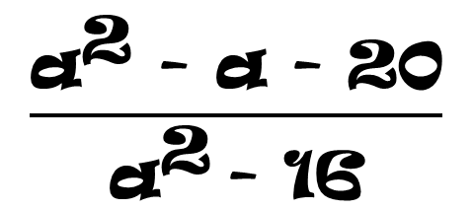
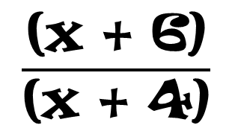
SIMPLIFY ALGEBRAIC FRACTIONS
$$\frac{{\text{x}}^{\text{2}}\text{ + 9}\text{x}\text{ + 18}}{{\text{x}}^{\text{2}} \text{+ 7}\text{x}\text{ + 12}}$$
1st Step
2nd Step
Trinomial x² + bx +c
$$\frac{\text{(}\text{x}\text{ + 6)(}\text{x}\text{ + 3)}}{\text{(}\text{x}\text{ + 4)(}\text{x}\text{ + 3)}}$$
Trinomial x² + bx + c
$$\frac{\text{(}\text{x}\text{ + 6)}}{\text{(}\text{x}\text{ + 4)}}$$
1st Step
2nd Step
$$\frac{{\text{a}}^{\text{2}}\text{ − }\text{a}\text{ − 20}}{{\text{a}}^{\text{2}} \text{− 16}}$$
Trinomial x² + bx +c
$$\frac{\text{(}\text{a}\text{ − 5)(}\text{a}\text{ − 4)}}{\text{(}\text{a}\text{ − 4)(}\text{a}\text{ + 4)}}$$
Difference of two squares
$$\frac{\text{(}\text{a}\text{ − 5)}}{\text{(}\text{a}\text{ + 4)}}$$

Slide 10
Let’s practice some exercises…

Slide 11

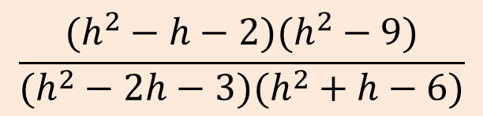


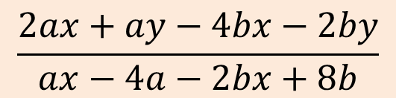

EXERCISES
Simplify the following expressions:
$$\frac{x^{2}y^{3}}{2x^{2}y−2x^{2}y^{2}}$$
$$\frac{x^{2}−1}{3x+9}∙\frac{xy+3y}{x^{2}y−y}$$
$$\frac{75a^{7}m^{5}}{100a^{3}m^{12}n^{3}}$$
$$\frac{2ax+ay−4bx−2by}{ax−4a−2bx+8b}$$
$$\frac{15a^{12}b^{15}c^{20}}{75a^{11}b^{16}c^{22}}$$
$$\frac{(h^{2}−h−2)(h^{2}−9)}{(h^{2}−2h−3)(h^{2}+h−6)}$$

Slide 12
Now, the least common multiple…

Slide 13
LEAST COMMON MULTIPLE
Remember the concept of the least common multiple according with the arithmetic:
The Least Common Multiple (L. C. M.) is the smallest number that is a multiple of both of them.
For our course, the common and no common expression with the greater exponent.

Slide 14
LEAST COMMON MULTIPLE
It is necessary to know how to find the L. C. M. depending the expression
L. c. m. of monomials
The process to find the L. C. M. of monomials consist of two steps.
1st Step
Find the l. c. m. of the numbers
Find the l. c. m. of the literals taking into account: “the common and uncommon expressions with their greater exponent”
2nd Step

Slide 15
LEAST COMMON MULTIPLE
For example, find the L. C. M. of the expressions
3a³, 8ab, 10b², 12a²b³, 16a²b²
3
8
10
12
16
2
3
4
5
6
8
2
3
2
5
3
4
2
240
3
1
5
3
2
2
3
1
5
3
1
3
1
1
5
1
1
5
Multiply all of them
1
1
1
1
1
a³b³
Second, find the common and no common literal with its greater exponent
First, find the L. C. M. of the numbers (coefficients)

Slide 16
Now, let’s practice…

Slide 17
LEAST COMMON MULTIPLE
Find the L. C. M. of the expressions:
24a²x³, 36a²y⁴, 40x²y⁵, 60a³y⁶
360a³x³y⁶
5h², 10hi, 15hi²
15h²i²
15rt², 10r², 20r³, 25rt⁴
300r³t⁴
Now the question is: “what happen with expression that are not monomials?”

Slide 18
LEAST COMMON MULTIPLE
The process is vey simple:
1st Step
Factor each polynomial
Find the l. c. m. of the expressions taking into account: “the common and uncommon expressions with their greater exponent”
2nd Step

Slide 19
LEAST COMMON MULTIPLE
Monomials
Example 1:
[2a, 4x – 8]
[2a, 4(x – 2)]
4a(x – 2)
4(x – 2)
Second, Find the common and uncommon expressions with their greater exponent
First, Factor each polynomial

Slide 20
LEAST COMMON MULTIPLE
Take it first
Example 2:
4ax² – 8axy + 4ay², 6b²x – 6b²y
4a(x – y)², 6b²(x – y)
Monomials
binomials
4ax² – 8axy + 4ay²
6b²x – 6b²y
12ab²
(x – y)²
Common factor
Common factor
4a(x² – 2xy + y²)
6b²(x – y)
Perfect square trinomial
4a(x + y)²
Second, Find the common and uncommon expressions with their greater exponent
The new expression is written as…
First, Factor each polynomial

Slide 21
Now, let’s operate with algebraic fractions…

Slide 22

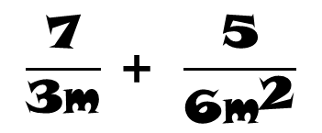
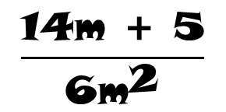
ADDITION OF ALGEBRAIC FRACTIONS
The process to add algebraic fractions is the same as the arithmetic…
First Step:
Find the L. C. M. (Denominators)
Divide by the bottom, multiply by the top
Second Step:
Third Step:
Add or subtract
Fourth Step:
Simplify (if it is possible)
$$\frac{\text{7}}{\text{3}\text{m}} \text{+ }\frac{\text{5}}{\text{6}{\text{m}}^{\text{2}}}$$
$$\frac{}{\text{6}\text{m}\text{2}} \text{+ }\frac{}{\text{6}\text{m}\text{2}}$$
$$\frac{\text{14}\text{m}\text{ + 5}}{\text{6}{\text{m}}^{\text{2}}}$$
14m
5
For example
=
=
3m, 6m²
6m²
6m² ÷ 3m = 2m ⋅ 7 = 14m
In this case, it is not possible
6m² ÷ 6m² = 1 ⋅ 5 = 5
Find the L. C. M. (Denominators)
Divide by the bottom, multiply by the top
Simplify (if it is possible)
Add or subtract

Slide 23
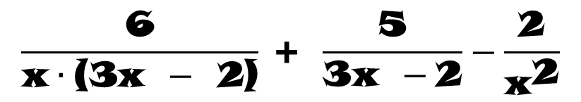

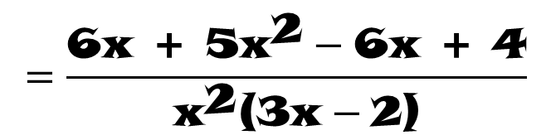
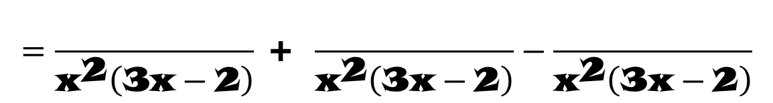

ADDITION OF ALGEBRAIC FRACTIONS
$$\frac{\text{6}}{\text{x}∙\text{(3}\text{x} −\text{ 2)}} \text{+ }\frac{\text{5}}{\text{3}\text{x} −\text{2}}−\frac{\text{2}}{{\text{x}}^{\text{2}}}$$
Another example
6x
5x²
6x – 4
$$=\frac{}{{\text{x}}^{\text{2}}\left(\text{3}\text{x}−\text{2}\right)} \text{+ }\frac{}{{\text{x}}^{\text{2}}\left(\text{3}\text{x}−\text{2}\right)}−\frac{}{{\text{x}}^{\text{2}}\left(\text{3}\text{x}−\text{2}\right)}$$
Rewrite it using algebra
$$=\frac{\text{6}\text{x}\text{ + 5}{\text{x}}^{\text{2}}−\text{6}\text{x}\text{ + 4}}{{\text{x}}^{\text{2}}\text{(3}\text{x}−\text{2)}}$$
$$\left[\text{x}\left(\text{3}\text{x}−\text{2}\right)\text{, 3}\text{x}−\text{2, }{\text{x}}^{\text{2}}\right]$$
x²(3x – 2)
[x²(3x – 2)] ÷ [x(3x-2)] = x ⋅ 6 = 6x
$$=\frac{\text{5}{\text{x}}^{\text{2}}\text{ + 4}}{{\text{x}}^{\text{2}}\text{(3}\text{x}−\text{2)}}$$
[x²(3x – 2)] ÷ [(3x-2)] = x² ⋅ 5 = 5x²
[x²(3x – 2)] ÷ x² = (3x – 2) ⋅ 2 = 6x – 4
In this case, it is not possible
Add or subtract
Find the L. C. M. (Denominators)
Divide by the bottom, multiply by the top
Simplify (if it is possible)

Slide 24
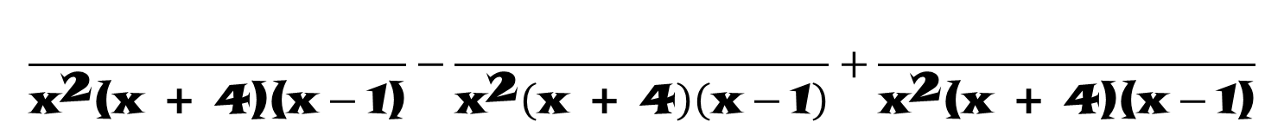
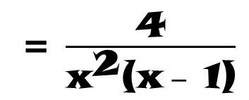
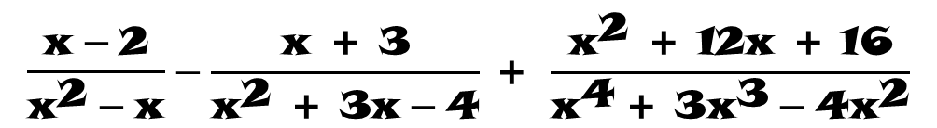
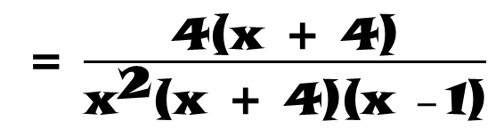
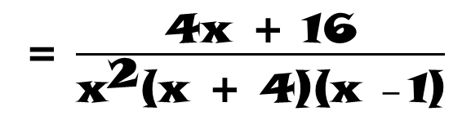
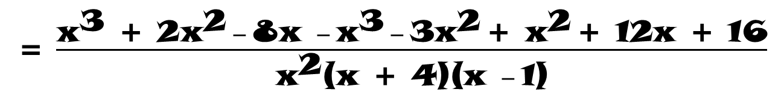
ADDITION OF ALGEBRAIC FRACTIONS
$$\frac{\text{x}−\text{2}}{{\text{x}}^{\text{2}}−\text{x}}−\frac{\text{x}\text{ + 3}}{{\text{x}}^{\text{2 }}\text{+ 3}\text{x}−\text{4}} \text{+ }\frac{{\text{x}}^{\text{2}}\text{ + 12}\text{x}\text{ + 16}}{{\text{x}}^{\text{4}} \text{+ 3}{\text{x}}^{\text{3}}−\text{4}{\text{x}}^{\text{2}}}$$
One more example
$$\frac{}{{\text{x}}^{\text{2}}\text{(}\text{x}\text{ + 4)(}\text{x}−\text{1)}}−\frac{}{{\text{x}}^{\text{2}}\left(\text{x}\text{ + 4}\right)\left(\text{x}−\text{1}\right)}+\frac{}{{\text{x}}^{\text{2}}\text{(}\text{x}\text{ + 4)(}\text{x}−\text{1)}}$$
x³ + 2x² – 8x
x³ + 3x²
x² + 12x +16
Rewrite it using algebra
= $\frac{{\text{x}}^{\text{3}}\text{ + 2}{\text{x}}^{\text{2}} − \text{8}\text{x} − {\text{x}}^{\text{3}} − \text{3}{\text{x}}^{\text{2}} \text{+ }{\text{x}}^{\text{2}} \text{+ 12}\text{x}\text{ + 16}}{{\text{x}}^{\text{2}}\text{(}\text{x}\text{ + 4)(}\text{x} − \text{1)}}$
x² – x
= $\frac{\text{4}\text{x}\text{ + 16}}{{\text{x}}^{\text{2}}\text{(}\text{x}\text{ + 4)(}\text{x} − \text{1)}}$
x(x – 1)
[x²(x+4)(x – 1)] ÷ [x(x – 1)] = [x(x + 4)](x – 2) = [x² + 4x](x – 2) = x³ + 2x² – 8x
Common factor
x² + 3x - 4
Quadratic trinomial
(x + 4)(x – 1)
= $\frac{\text{4}\text{(}\text{x}\text{ + 4)}}{{\text{x}}^{\text{2}}\text{(}\text{x}\text{ + 4)(}\text{x} − \text{1)}}$
= $\frac{\text{4}}{{\text{x}}^{\text{2}}\text{(}\text{x} − \text{1)}}$
[x²(x + 4)(x – 1)] ÷ [(x + 4)(x – 1)] = x²(x + 3) = x³ + 3x²
x⁴ + 3x³ – 4x²
Common factor
x²(x² + 3x - 4) = x²(x + 4)(x -1)
[x²(x + 4)(x – 1)] ÷ [x²(x + 4)(x – 1)] = 1⋅(x2 + 12x + 16) = x² + 12x +16
L. C. D. → x²(x + 4)(x -1)
Find the L. C. M. (Denominators)
Add or subtract
Divide by the bottom, multiply by the top
Simplify (if it is possible)

Slide 25

MULTIPLICATION OF ALGEBRAIC FRACTIONS
As arithmetic, the process to multiply algebraic fractions is…
Multiply:
numerator with numerator and denominator with denominator
For example
x
1
$$\frac{\text{2}\text{a}}{\text{3}{\text{b}}^{\text{3}}}\text{×}\frac{\text{3}{\text{b}}^{\text{2}}}{\text{4}\text{x}}\text{×}\frac{{\text{x}}^{\text{2}}}{\text{2}{\text{a}}^{\text{2}}}$$
1
x
=
4ab
1
b
1
a
Multiply numerator with numerator and denominator with denominator

Slide 26





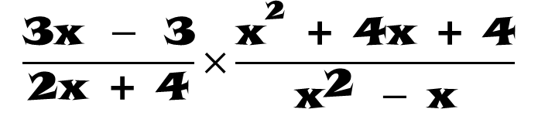







MULTIPLICATI0N OF ALGEBRAIC FRACTIONS
$$\frac{\text{3}\text{x} −\text{ 3}}{\text{2}\text{x}\text{ + 4}}\text{×}\frac{{\text{x}}^{\text{2}}\text{ + 4}\text{x}\text{ + 4}}{{\text{x}}^{\text{2}} − \text{x}}$$
Another example
x + 2
1
$${\text{(}\text{x}\text{ + 2)}}^{\text{2}}$$
x + 2
$$\text{3}\text{(}\text{x} − \text{1)}$$
×
=
$$\text{2}\text{(}\text{x}\text{ + 2)}$$
$$\text{x}\text{(}\text{x}−\text{1)}$$
2x
1
1
$$\text{3}\text{x} −\text{ 3}$$
Common Factor
$$\text{3}\text{(}\text{x} − \text{1)}$$
$$\text{2}\text{x}\text{ + 4}$$
Common Factor
$$\text{2}\text{(}\text{x}\text{ + 2)}$$
$${\text{x}}^{\text{2}}\text{ + 4}\text{x}\text{ + 4}$$
$${\text{(}\text{x}\text{ + 2)}}^{\text{2}}$$
Perfect Square Trinomial
$${\text{x}}^{\text{2}} − \text{x}$$
Common Factor
$$\text{x}\text{(}\text{x}−\text{1)}$$
First, it have to factor each expression
Second, simplify
Third, multiply

Slide 27

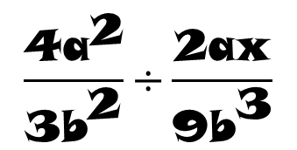

DIVIDING ALGEBRAIC FRACTIONS
To divide algebraic fractions, it must be to apply the same process as arithmetic…
To change division by multiplication
Invert the second term of the division (reciprocal)
a
b
2
3
$$\frac{\text{4}{\text{a}}^{\text{2}}}{\text{3}{\text{b}}^{\text{2}}}\text{÷}\frac{\text{2}\text{ax}}{\text{9}{\text{b}}^{\text{3}}}$$
$$\frac{\text{4}{\text{a}}^{\text{2}}}{\text{3}{\text{b}}^{\text{2}}}×$$
$$\frac{\text{9}{\text{b}}^{\text{3}}}{\text{2}\text{ax}}$$
6ab
For example
=
x
1
1
1
1
…do as a multiplication – in front –
Change the division by multiplication…
…invert the second term (reciprocal)…

Slide 28
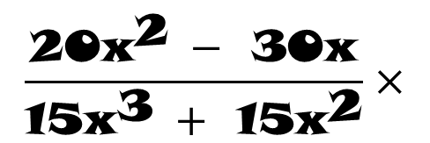
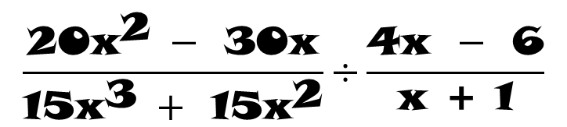
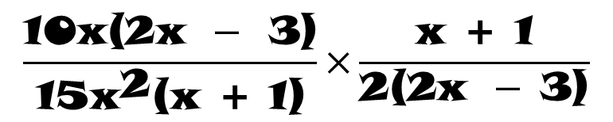
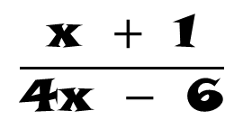
DIVIDING ALGEBRAIC FRACTIONS
As Arithmetic, the division of algebraic fractions is done as follows…
To change division by multiplication
Invert the second term of the division (reciprocal)
Let’s see another example
$$\frac{\text{20}{\text{x}}^{\text{2}} −\text{ 30}\text{x}}{\text{15}{\text{x}}^{\text{3}} +\text{ 15}{\text{x}}^{\text{2}}}\text{÷}\frac{\text{4}\text{x} −\text{ 6}}{\text{x}\text{ + 1}}$$
$$\frac{\text{20}{\text{x}}^{\text{2}} −\text{ 30}\text{x}}{\text{15}{\text{x}}^{\text{3}} +\text{ 15}{\text{x}}^{\text{2}}}×$$
$$\frac{\text{x} + \text{1}}{\text{4}\text{x} − \text{6}}$$
1
5
1
1
1
1
$$\frac{\text{10}\text{x}\text{(2}\text{x} −\text{ 3)}}{\text{15}{\text{x}}^{\text{2}}\text{(}\text{x}\text{ + 1)}}\text{×}\frac{\text{x}\text{ + 1}}{\text{2(2}\text{x} − \text{3)}}$$
=
3x
3
x
1
1
1
Change the division by the multiplication…
…factoring each term…
…invert the second term (reciprocal)…
…operate as a multiplication – from front –

Slide 29
Let’s practice…

Slide 30
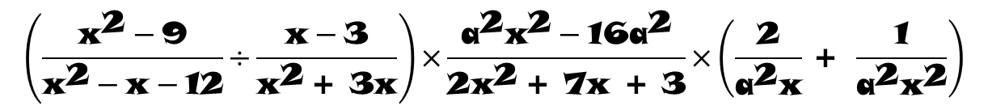
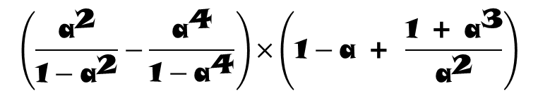
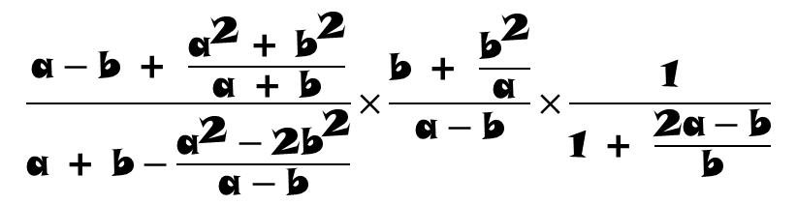
Exercises
Solve the following exercises:
$$\left(\frac{{\text{a}}^{\text{2}}}{\text{1}−{\text{a}}^{\text{2}}}−\frac{{\text{a}}^{\text{4}}}{\text{1}−{\text{a}}^{\text{4}}}\right)\text{×}\left(\text{1}−\text{a}\text{ + }\frac{\text{1 + }{\text{a}}^{\text{3}}}{{\text{a}}^{\text{2}}}\right)$$
$$\left(\frac{{\text{x}}^{\text{2}}−\text{9}}{{\text{x}}^{\text{2}}−\text{x}−\text{12}}\text{÷}\frac{\text{x}−\text{3}}{{\text{x}}^{\text{2}} \text{+ 3}\text{x}}\right)\text{×}\frac{{\text{a}}^{\text{2}}{\text{x}}^{\text{2}}−\text{16}{\text{a}}^{\text{2}}}{\text{2}{\text{x}}^{\text{2}} \text{+ 7}\text{x}\text{ + 3}}\text{×}\left(\frac{\text{2}}{{\text{a}}^{\text{2}}\text{x}} \text{+ }\frac{\text{1}}{{\text{a}}^{\text{2}}{\text{x}}^{\text{2}}}\right)$$
$$\left(\frac{\text{1}}{\text{x}}−\frac{\text{2}}{\text{x}\text{ + 2}} \text{+ }\frac{\text{3}}{\text{x}\text{ + 3}}\right)\text{÷}\left(\frac{\text{x}}{\text{x}\text{ + 2}}\text{+}\frac{\text{x}}{\text{x}\text{ + 3}}\text{+}\frac{\text{6}}{{\text{x}}^{\text{2}} \text{+ 5}\text{x}\text{ + 6}}\right)$$
$$\frac{\text{a}−\text{b}\text{ + }\frac{{\text{a}}^{\text{2}} \text{+ }{\text{b}}^{\text{2}}}{\text{a}\text{ + }\text{b}}}{\text{a}\text{ + }\text{b}−\frac{{\text{a}}^{\text{2}}−\text{2}{\text{b}}^{\text{2}}}{\text{a}−\text{b}}}\text{×}\frac{\text{b}\text{ + }\frac{{\text{b}}^{\text{2}}}{\text{a}}}{\text{a}−\text{b}}\text{×}\frac{\text{1}}{\text{1 + }\frac{\text{2}\text{a}−\text{b}}{\text{b}}}$$
Email us your answer and you will receive your feedback

