Slide 1

Subtracting polynomials
Contact us:
→ a.m.e.asesoriasmatematicas@gmail.com
→ asesoriasmatematicas0.webnode.com.co
→ @asesoriasmatematicas0
→ @a.m.e._asesorias_matematicas

Slide 2
Some things to consider…

Slide 3
Definitions
In algebra, subtracting means to change signs.
There are three different ways to show the subtraction:
1°) From … subtract …
2°) Subtract … from …
3°) (…) – (…)

Slide 4
Let see the process using monomials…

Slide 5
Subtracting monomials
polynomial that comes after word “subtract” changes all its signs.

Slide 6

Subtracting monomials
From – 4
subtract 7
– 4 – 7
= -11
subtract 4b
from 2a
–4b + 2 a
← They are not like terms
(- 5a²b)
-
(4a²b)
← 2nd parenthesis must change all its sings
4a²b
=
- 9a²b
Polynomial that comes after word “subtract” changes all its signs…

Slide 7
Now, let’s move with polynomials…

Slide 8
Subtracting polynomials
Remember that the polynomial that comes after word “subtract” or minus sign changes all its signs.
That means that “subtrahend” must change its signs.

Slide 9
Subtracting polynomials
From 4x - 3y + z subtract 2x + 5z - 6
4x - 3y + z
2nd polynomial must change its signs.
1st polynomial stays equal
- 2x - 5z + 6
=
2x – 3y – 4z + 6
Let see another example:
Subtract -4a⁵b - ab⁵ + 6a³b³ – a²b⁴ - 3b⁶ from 8a⁴b² + a⁶ - 4a²b⁴ + 6ab⁵
8a⁴b² + a⁶ - 4a²b⁴ + 6ab⁵
+ 4a⁵b + ab⁵ - 6a³b³ + a²b⁴ + 3b⁶
Polynomial that comes after word “subtract” must change its signs
a⁶
+ 4a⁵b
+ 8a⁴b²
- 6a³b³
- 3a²b⁴
+ 7ab⁵
Polynomial that comes after word “from” stays the same
Let’s operate like terms
+ 3b⁶

Slide 10
Let’s practice together…

Slide 11
Subtracting polynomials
Simplify the following expressions:
Subtract –8a²x + 6 – 5ax² – x³ from 7a³ + 8a²x + 7ax² – 4
Let’s see the answer
7a³ + 8a²x + 7ax²
– 4
+ 8a²x
+ 5ax²
+ x³
- 6
7a³
+ 16a²x
+ 12ax²
+ x³
- 10

Slide 12
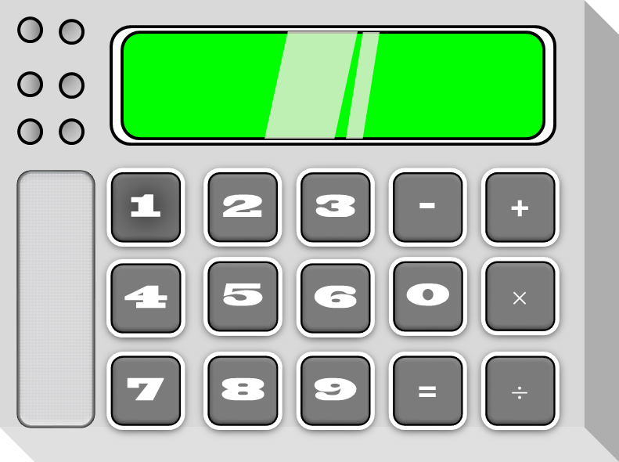
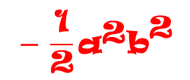

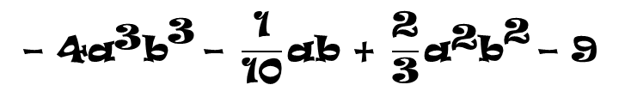
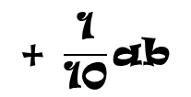


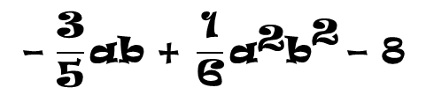

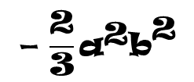

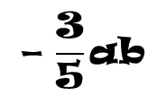

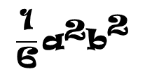
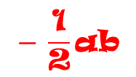

Subtracting polynomials
Now try this exercise:
$$\text{−} \frac{\text{3}}{\text{5}}\text{ab}\text{ + }\frac{\text{1}}{\text{6}}{\text{a}}^{\text{2}}{\text{b}}^{\text{2}} \text{− 8}$$
From
Subtract
$$\text{− 4}{\text{a}}^{\text{3}}{\text{b}}^{\text{3}} \text{− }\frac{\text{1}}{\text{10}}\text{ab}\text{ + }\frac{\text{2}}{\text{3}}{\text{a}}^{\text{2}}{\text{b}}^{\text{2}} \text{− 9}$$
$$\frac{\text{1}}{\text{6}}{\text{a}}^{\text{2}}{\text{b}}^{\text{2}}$$
$$\text{−} \frac{\text{3}}{\text{5}}\text{ab}$$
– 8
4a³b³
$$\text{−} \frac{\text{2}}{\text{3}}{\text{a}}^{\text{2}}{\text{b}}^{\text{2}}$$
$$\text{+ }\frac{\text{1}}{\text{10}}\text{ab}$$
+ 9
$$− \frac{\text{1}}{\text{2}}{\text{a}}^{\text{2}}{\text{b}}^{\text{2}}$$
$$− \frac{\text{1}}{\text{2}}\text{ab}$$
4a³b³
+ 1
$$\frac{\text{1}}{\text{6}} \text{− }\frac{\text{2}}{\text{3}}$$
$$\frac{\text{3−12}}{\text{18}}$$
$$\frac{− \text{9}}{\text{18}}$$
$$−\frac{\text{1}}{\text{2}}$$
$$=$$
$$=$$
$$=$$

Slide 13
Now practie at home…

Slide 14
Subtracting polynomials
Solve the following exercises:
From 5m³ – 9n³ + 6m²n – 8mn² subtract 14mn² – 21m²n + 5m³ – 18.
From 4x³y – 19xy³ + y⁴ – 6x²y² subtract -x⁴ – 51xy³ + 32x²y² – 25x³y .
Subtract 25h + 25h3 – 18h2 – 11h5 – 46 from h 3 – 6h4 + 8h2 – 9 + 15h
Subtract g⁷ – 60f⁴g³ + 90f³g⁴ – 50fg⁶ – f²g⁵ from f⁷ – 3f⁵g² + 35f⁴g³ – 8f²g + 60
$\text{Subtract}\text{ -}\frac{\text{5}}{\text{11}}{\text{c}}^{\text{4}}\text{d}\text{ - }\frac{\text{3}}{\text{13}}{\text{d}}^{\text{5}} \text{- }\frac{\text{5}}{\text{6}}{\text{c}}^{\text{3}}{\text{d}}^{\text{2}} \text{+ }\frac{\text{3}}{\text{4}}\text{c}{\text{d}}^{\text{4}}$
$$\text{from} \frac{\text{3}}{\text{8}}{\text{c}}^{\text{5}} \text{+ }\frac{\text{1}}{\text{2}}{\text{c}}^{\text{2}}{\text{d}}^{\text{3}} \text{− }\frac{\text{1}}{\text{3}}{\text{d}}^{\text{5}} \text{+ }\frac{\text{7}}{\text{12}}{\text{c}}^{\text{3}}{\text{d}}^{\text{2}} \text{+ }\frac{\text{7}}{\text{22}}{\text{c}}^{\text{4}}\text{d}\text{ − 35}$$
Send us your answers to our email and get your feedback.

Slide 15
The End
Mr. Erick Duque Barragán
a.m.e.asesoriasmatematicas@gmail.com
Exercises was taken from Baldor book

